Slide 1



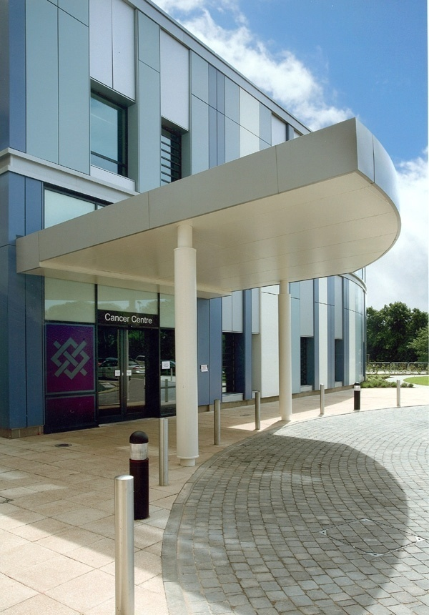
Efficiency of emergency assessment bay model for oncohaematological related emergencies
EFFICIENCY OF EMERGENCY ASSESSMENT BAY (EAB) MODEL
FOR ONCO-HAEMATOLOGICAL RELATED EMERGENCIES
Patient benefit:-
24hour direct access to expert medical and nursing advice, care and treatment
Trust benefit:-
Sustained timely, effective management of Onco-Haematological emergencies through improved patient pathways
Introduction
The opening of the new Cancer Centre provided an opportunity to introduce a facility for admission of oncology/haematology patients directly to the cancer centre, bypassing the Emergency Department. The Emergency Assessment Bay (EAB), with a 24 hour helpline facility and dedicated medical and specialist nursing cover 24/7, affords patients access to more appropriate and timely care, early implementation of treatment, reduction in risk by patients being appropriately managed by specialist teams, avoidance of inappropriate admissions and the potential for reduction in length of stay all of which serve to improve their experience.
The aims and objectives of the Emergency Assessment Bay were, and continue to be, to ensure timely and effective management of onco-haematological emergencies by providing direct access to the Cancer Centre; to act in accordance with national directives to provide urgent specialist treatment to patients receiving systemic anti-cancer treatment; to effectively manage bed pressures thereby reducing pressure on emergency portals; to improve the patient care pathway and access to an expert workforce positively affecting patient experience; to improve patient outcome associated with emergency management of oncology/haematology emergencies.
Most proud of:
• 2, 179 contacts between April 2011 & March 2012
• 1, 236 patients given advice or assessed, and
discharged home, therefore, avoiding admission
• Safe, appropriate care for all emergencies
• Strong working relationship of medical and nursing
teams
• Positive patient feedback
• Example within the network and recognised as
area of good practice
• Support and advice being requested of us from
other Trusts
What has been the impact of implementing the
Emergency Assessment Bay?
The implementation of the EAB always had the care of the patient at the centre of its intended purpose. The provision of safe, effective and timely care in managing their Oncological/Haematological emergency has always been the intention for its use. The impact upon patient care has been proved to avoid admissions; be provided with appropriate medication, advice and on-going support; a reduction in length of stay and associated risks of hospital acquired infections and improves overall satisfaction and experience of the emergency care pathway for patients attending EAB at the Cancer Centre.
The team, and Directorate as a whole, remains keen to promote how EAB has improved service to our patients, improved access to emergency advice, care and treatment and how it has also benefitted the Trust and wider healthcare economy. We have achieved this already through attendance at Urgent Care Conferences locally, receiving teams from visiting Trusts; poster presentations and sharing our experience through discussions.
However, marketing EAB continues to be a focus of the Directorate to ensure sharing aims and objectives and experiences of implementing new pathways, to benefit others, remains high on the meeting our patients needs and the service improvement agenda.
Summary
The Emergency Assessment Bay has now been operational for over 3 years having being one of a kind with regard to a facility to accommodate emergency care and treatment for Haemato-Oncological patients within an acute Trust. Prior to the facility opening there was uncertainty about how the models of care, and patient pathways, would work and how the service would be received both by patients and the wider healthcare economy. All expectations have been exceeded with positive feedback from patients, carers and healthcare professionals accessing the facility and the Directorate is committed to constantly reviewing systems, processes and revising where required staffing models and resource requirements.
The sustainability of the service is demonstrated through the ongoing auditing of this service as seen in the Directorate’s End of Year report. Data supports the utilisation of the Emergency Assessment Bay with a continuing increase in the activity since the facility opened.
The use of the 24 hour Telephone Assessment Tool has enabled appropriate triaging of patients to ensure safe, effective and appropriate clinical care and/or advice is given and defined clinical pathways ensure ongoing relevance to patient management.
Contact Details
Rachael Morgan-Lovatt
Oncology ANP
Rachael.morganlovatt@uhns.nhs.uk

Slide 2
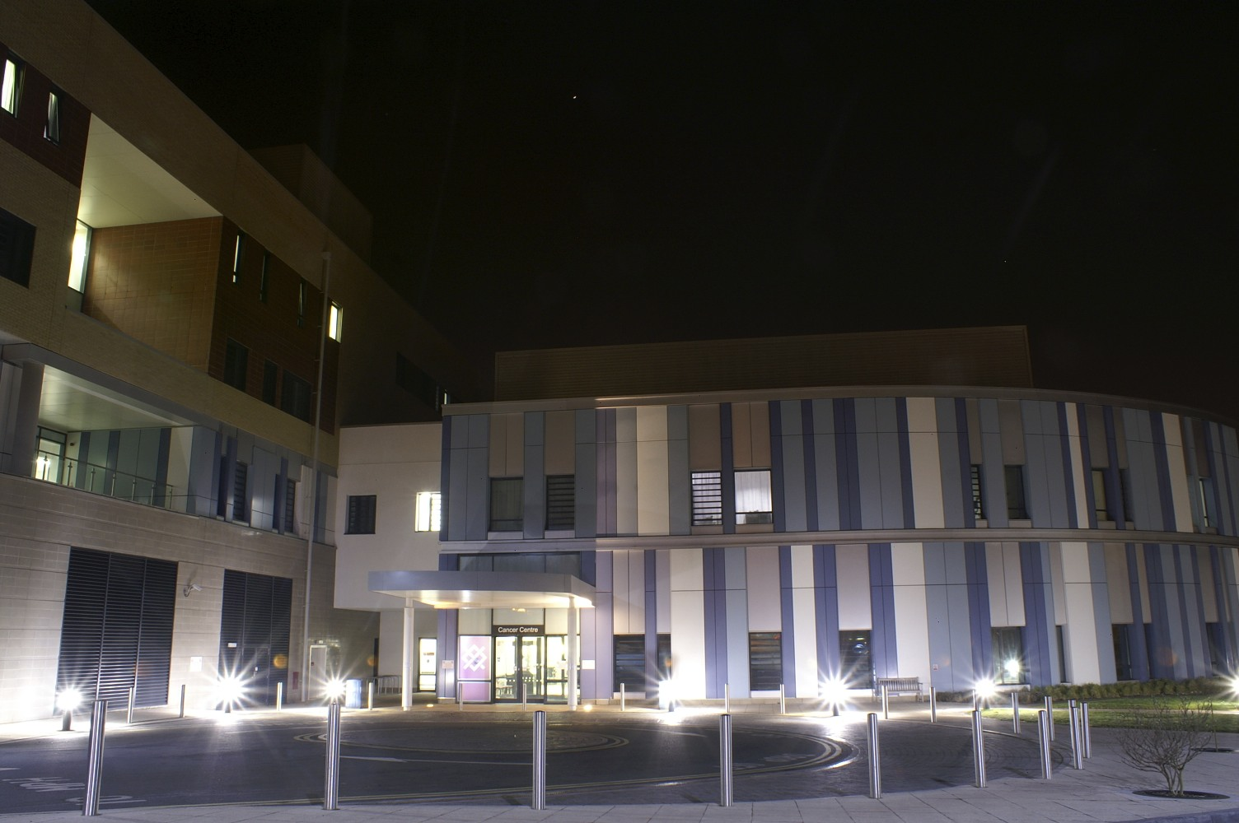
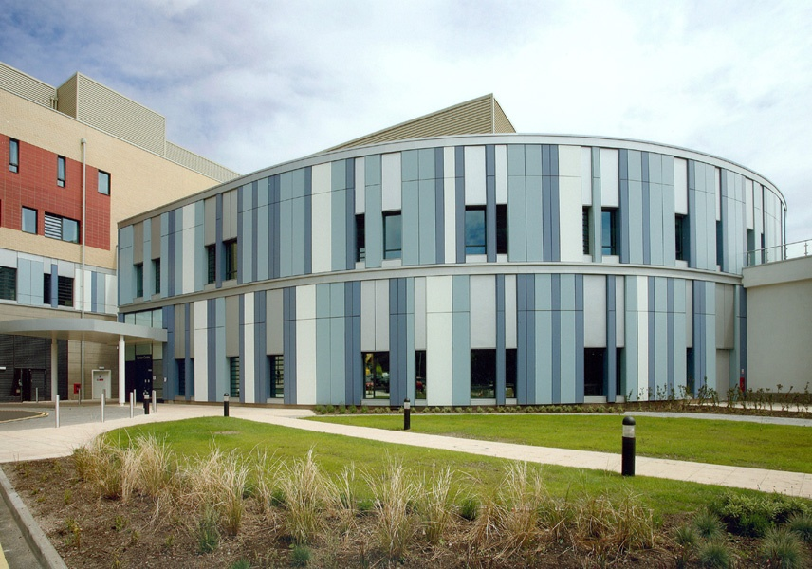
UHNS Emergency Assessment Bay
Enhancing the patients experience
24hour availability
Positive Feedback
through Audit
What our patients really think of us.
If you have attended the Emergency Assessment Bay at the Cancer Centre please use this short questionnaire to tell us about your experience.
Defined Patient Pathway
Self
GP
Clinic
A&E
Telephone triage
Admit to EAB?
No
Refer to appropriate specialty
Enhanced
Patient
Experience for Emergency
Care
Yes
Patient assessed
Admit to Ward 201
Discharge home
Transfer to appropriate Specialty

