Slide 1

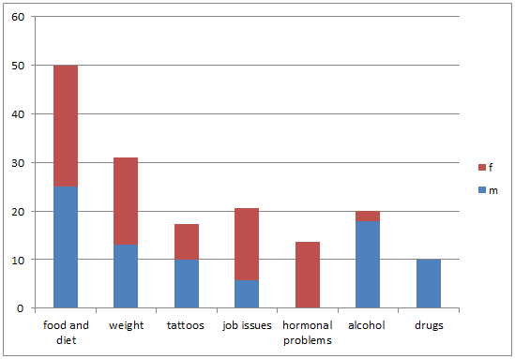
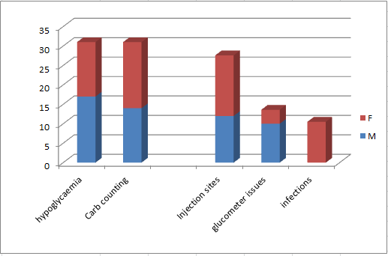
Pre-clinic Questionnaire-What do young adults with type 1 diabetes want to discuss?
A.Scroxton, F.Cook, N.Kelly, D.Kalathil, T.S.Purewal, R.Zaidi
Royal Liverpool and Broadgreen University Hospitals NHS Trust
Introduction
Results
Patient engagement during young adult diabetes clinics can be challenging and multifactorial. In addition, the clinic dropout and non-attendance rates are some of the highest nationally. We aim to focus consultations by using a pre-clinic questionnaire to identify popular lifestyle and diabetes topics among the young adult diabetes clinic patient population.
Aims and method
Aims:
To analyse the common lifestyle and diabetes related issues our cohort of young adults with type 1 diabetes wanted to discuss
To identify common themes and topics chosen by male and female patients
Methods:
In this qualitative study we analysed 29 pre-clinic questionnaires over 4 weeks
Each questionnaire had 16 lifestyle related and 11 diabetes related
There was no limit to choosing the discussion topics
Lifestyle topics chosen on pre clinic questionnaire by male and female patients. Bars show percentage of overall patients who selected topics (m=male, f=female). men more commonly wanted to discuss alcohol (20%) and drugs (10%) whilst job related issues (26.31%) and hormonal problems (15.80%) were more commonly discussed amongst women
Figure 1: Pre clinic Diabetes questionnaire. Containing consultation topics on both diabetes and lifestyle issues
Issue: | Anything specific?
Sports and exercise
Travel and holiday advice
Alcohol
Tattoos and body piercing
Driving
Sex/pre-conception advice
Attending music festivals
Drugs
Smoking
Food and diet
Weight issues
Hormonal problems
Moving home/ University
Job related issues
Need more information resources
Issue: | Anything specific?
Hypoglycaemia
Injection sites
Carbohydrate counting
Unpredictable glucose patterns
Glucose meter related issues
Illness and glucose/ketone monitoring
Compliance/missing doses
Frequent infections
Worsening retinopathy/nephropathy/neuropathy
Insulin regimen
Other:
Diabetes and Diabetes management related topics chosen on pre clinic questionnaire. Bars represent overall percentage of patients who selected topics. Common topics for discussion amongst all patients were hypoglycaemia (31%), carbohydrate counting (31%), injection sites (27.6%), glucometer related problems (13.8%). Additionally, 10.5% women wanted to discuss infections
Conclusion
Introduction of this pre-clinic questionnaire has given us an insight into the issues young adults with type 1 diabetes most commonly wanted to discuss, highlighted some differences in topics between men and women and, in general, made the clinic consultation more stream-lined.

