Slide 1

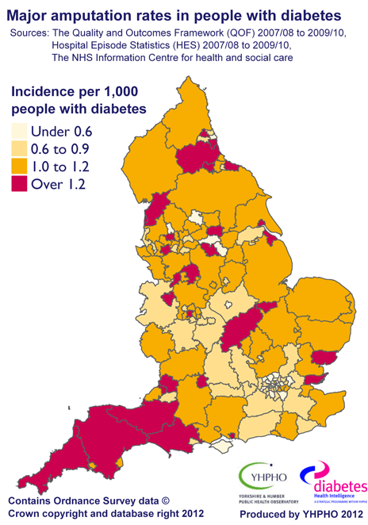
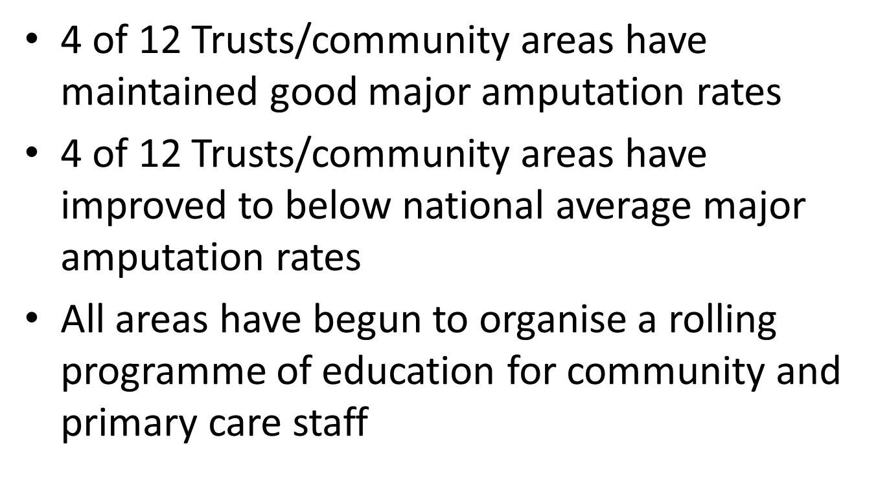
HES data, patient experience and local statistics in diabetes foot care in the South West- can peer reviews of diabetes foot care services improve outcomes?
R B Paisey, D Browne, M Bamford of the South West Strategic Clinical Network (Cardiovascular)
Introduction
Aims
To make multidisciplinary team peer review visits to all 11 CCGs (14 acute trusts) in the SW 2014-2015
To chart progress from previous NHS Diabetes reviews 2012-2013
Excuses or challenges!
Age
Ethnicity
Legacy effect
Rural population
Lack of detail
Methods 1-preliminary information
Acquisition of preliminary information including:
Report of previous NHS Diabetes review
Within area variation in amputation rates
CCG and MDT patient and staff profiles
Pathways and guidelines
Historical HES data
Methods 2- the visit
Reviewers-Podiatry leads; diabetologists; surgeons; SW SCN Quality Improvement Lead
4 patient interviews
10 case note reviews
Primary care and CCG perspective
Community podiatry provision skill mix and waiting times
MDT and Hospital staff and facilities
Admin support and communication
Results 1 heterogeneity of service provision
CCG
NHS Trust Hospital
Social enterprise
General
Practice
Nursing and residential homes
Patient
and carer
Results 2-Good Practice
Practice referral of all high risk patients
Virtual clinics and community staff education
Summary sheets for new ulcer cases
Accessible electronic records
Early curative surgery for osteomyelitis
Podiatrist prescribers
Integrated care pathways and liaison
Orthotics available and prompt
Vascular surgery support to Spoke Hospitals
Specialised commissioning for vascular services
Results 3 service provision and outcome
centre | Data base | MDT | Orthotics In clinics | Pod lead for foot service | Com podiatry
1 | + | + | + | + | +
2 | + | + | + | + | +
3 | - | + | + | - | +
4 | + | + | + | + | -
5 | - | +/- | - | - | +
6 | - | +/- | - | - | +
7 | - | - | - | + | +
8 | - | - | - | - | +
9 | - | - | - | - | +
10 | - | - | + | - | -
A
M
P
U
T
A
T
I
O
N
R
A
T
e
Results 4 changes from 1st to 2nd review
All 14 Trusts visited
8 have increased podiatry staffing
6 have consolidated or started MDT’s
6 rotate podiatrists between community and MDT
5 have job planning for MDT team
8 have rationalised information trails
2 have sufficient A&C and IT support
Conclusions-the necessary service provision
Results 5-changes from 1st to 2nd review
Patient education at Practice annual review
Rolling education programme for community health care professionals
Adequate community podiatry numbers and skill mix and rotation into MDT
Pathways and communication
Identification of diabetic in-patients and their foot checks
Ulcer data base and root cause analysis 3 monthly of all amputations
Job planned MDT weekly
Admin and IT support
Orthotist an integral part of MDT
Vascular presence in Spoke Hospitals
R B Paisey, SW Strategic Clinical Network March 2015

