Slide 1


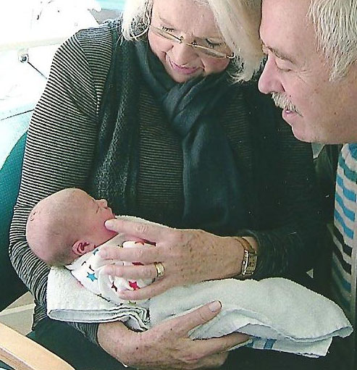
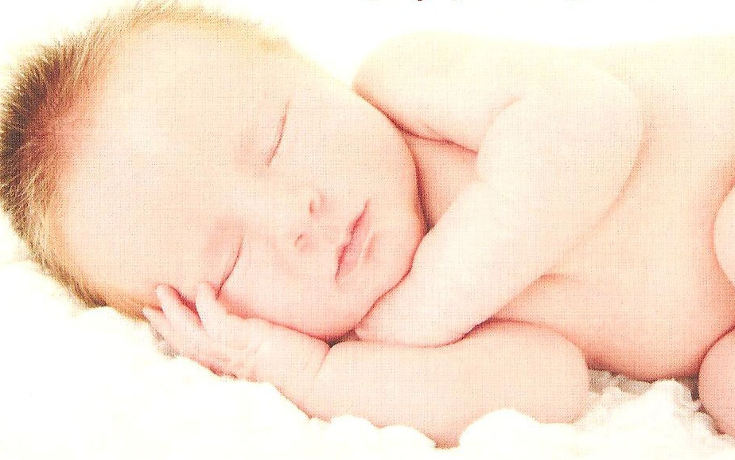
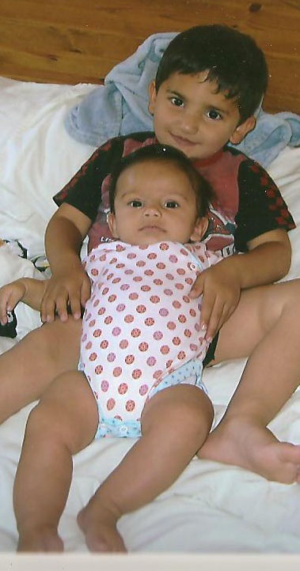
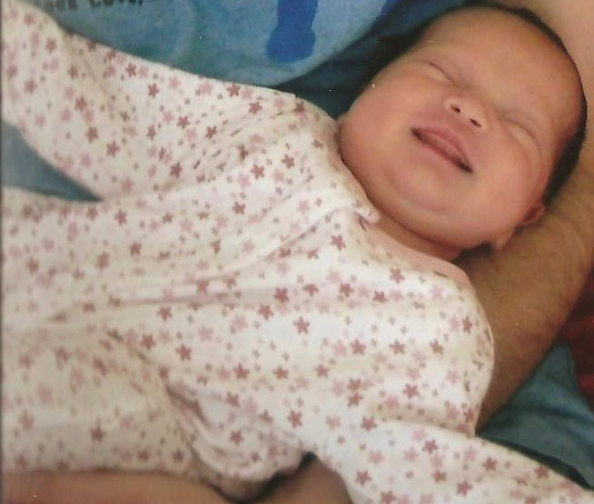



PROCEED
Preconception Care for Diabetes in Derby / Derbyshire
A “teams without walls” approach to preconception care
Author
Paromita King
Consultant physician
On behalf of the PROCEED Team
Some PROCEED babies and their Mum’s views
Dr King and the team provide a first class service. We felt privileged to be part of it
Brilliant, seen at 8.30 before work, Karen has been very supportive
It calmed me down knowing with good control I can minimise the risks
100% thumbs up!
A video of some other user views can be accessed via the web link below:
http://dl.dropbox.com/u/75004548/userviews.wmv
In partnership with:
and support from:

