Slide 1


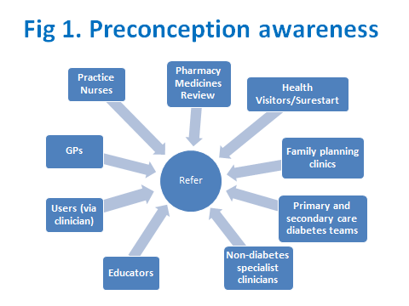
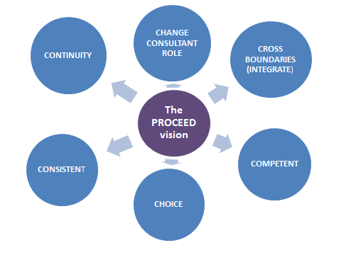
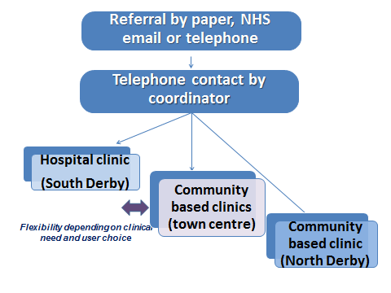
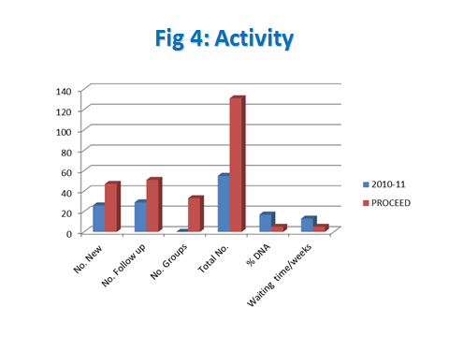
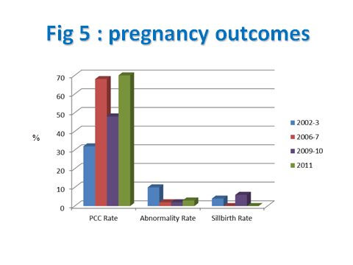
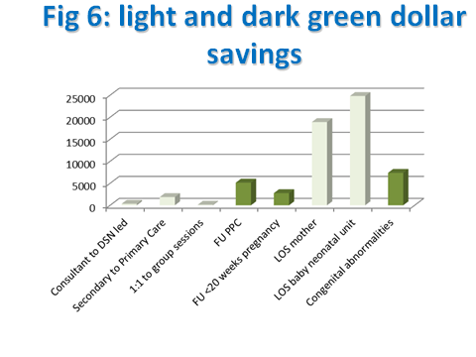



PROCEED
Preconception Care for Diabetes in Derby / Derbyshire
A “teams without walls” approach to preconception care
Author
Paromita King
Consultant physician
On behalf of the PROCEED Team
The Problem
Women with diabetes are 2-4 times as likely to have a baby with a congenital abnormality, and 5 times as likely to experience a stillbirth compared to a woman without diabetes.
Effective preconception care (PCC), particularly tightening glucose control, reduces these risks, but nationally only 34% access PCC.
Locally, we raised awareness of the need for PCC in primary care and set up dedicated multidisciplinary slots in our antenatal clinic which increased PCC rates from 32% in 2002/3 to 68% in 2006/7. Abnormality rates fell from 10% to 2% and still births from 4% to 0.
With a reduction in capacity following diabetes service reconfiguration, rates progressively dropped and by 2009/10 , adverse pregnancy outcomes had increased, with a 6% stillbirths rate.
In addition some users found the antenatal clinic setting was a stressful environment for those with infertility or a history of miscarriage
The solution: PROCEED
We raised awareness of the need for PCC amongst all professionals in contact with women with diabetes, and also sent written information to women with diabetes aged 18-45. (Fig 1)
Developed an innovative model for PCC (Fig 2,3):
We utilised all resources with the appropriate competencies across primary and secondary care, and for the first time integrated the preconception service horizontally across the boundaries of primary and secondary care as well as vertically across specialities.
After discussion with users, they were given a choice of clinics in hospital and community settings, flexibility with appointment times and contact by telephone and e mail as well as face to face appointments.
Women had an initial multidisciplinary consultation, and a care plan formulated which was implemented using resources across primary and secondary care as appropriate
We changed the Consultant Physician role from service delivery only to seeing those at highest risk, providing mentorship and optimising the lean delivery of the care pathway (Fig 3)
A care bundled approach including regular PDSA cycles was used to evaluate the project and a database designed to facilitate this.
Results, Figs 4-6. PROCEED:
Improved effectiveness, efficiency and timeliness
Activity doubled and median waiting time reduced from 13 to 5 weeks despite a 50% increase in capacity, demonstrating efficiency.
The proportion of appointments that were not attended reduced from 18% to 5%.
After 12 months, the PCC rate rose from 48 to 70%. The stillbirth rate reduced from 6% to 0
Provided a person centred service with improved equity
Feedback from users (below), together with fewer appointments that were not attended supported the fact that we were meeting their needs.
We engaged more women from traditionally hard to reach groups, particularly young adults and South Asian women from low socio-economic groups.
Ensured and improved Safety
Quality of care was not compromised by changing from a Consultant to a Nurse led service with spread across a wider geographical area.
The improvement in pregnancy outcomes supports an improvement in safety.
Financial savings
PROCEED saved £61,000 (Fig 6) . The main impact of PCC was through reducing birth defects, outpatient activity, and length of stay.
£15,200 were dark green dollar savings.
Learning
PROCEED has improved quality whilst saving money.
Support for raising preconception awareness came from unexpected sources – the community pharmacists made preconception the centre of their audit projects for 2011.
Working in partnership with users was invaluable in gaining an understanding of their needs.
Undertaking regular PDSA cycles was essential to refining this project.
It is easy to underestimate the difficulties in evaluating costs and savings. The database, and involvement of a finance manager were invaluable, but involvement of a health economist would have further added to the evaluation.
Fig 2: PROCEED model vision
Fig 3: Clinical Pathway
User Views
Dr King and the team provide a first class service. We felt privileged to be part of it
Brilliant, seen at 8.30 before work, Karen has been very supportive
It calmed me down knowing with good control I can minimise the risks
In partnership with:
and support from:

