Slide 1
Impact of Endobarrier on fatty liver
This is clear to see on the images
The difference between the images at the top is because of the high fat content
This difference has gone after the weight loss indicating that the fat has gone

Slide 2
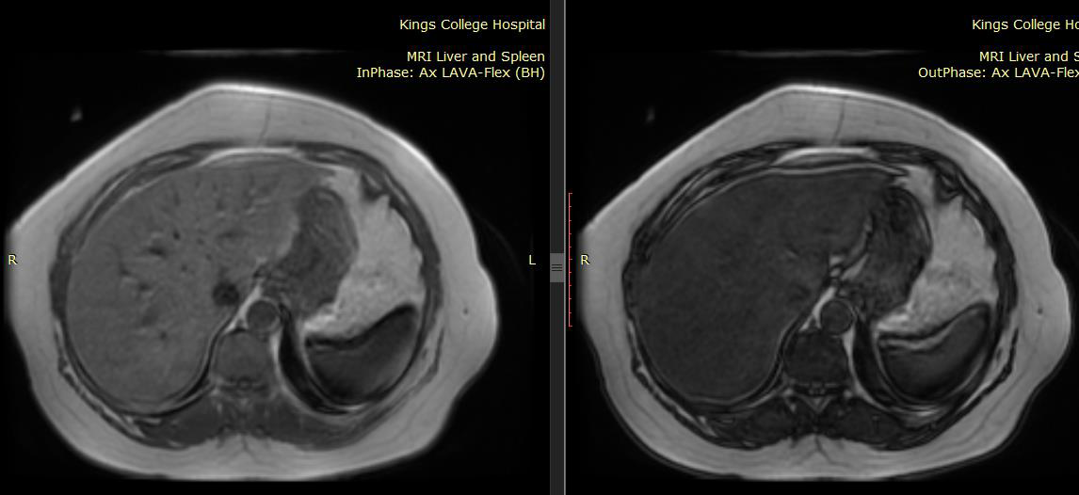
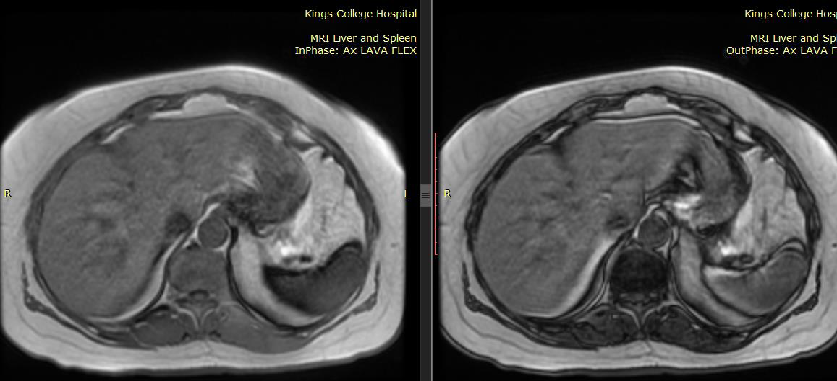
Summary
Liver fat pre- and post-MR images
In-Phase
Out of phase
Baseline
Fat fraction 22.4%
4-months
post-Endobarrier
Fat fraction 0.5%
Data presented at DDW 2016, San Diego USA, May 2016
Notes:
Representative axial MRI of the liver. A&B are the separated in-phase and out-of phase images.
C&D are the equivalent images. Right image appears darker (loss of signal compared to left image – suggesting high intrinsic fat content.
In comparison, little alteration between in phase and out of phase images after endobarrier suggesting a lower fat content.
This was reflected in the actual standard uptake values such that calculated hepatic fat was 22.4% baseline, 0.5% post endobarrier.

Slide 3
Summary
MRI analysis
Mean hepatic fat fraction
14.9 ± 9.4% to 2.9 ± 4.5%, p=0.003
Mean pancreatic fat fraction
6.9% to 1.3% post-endobarrier, p=0.02
Data presented at DDW 2016, San Diego USA, May 2016

