Slide 1
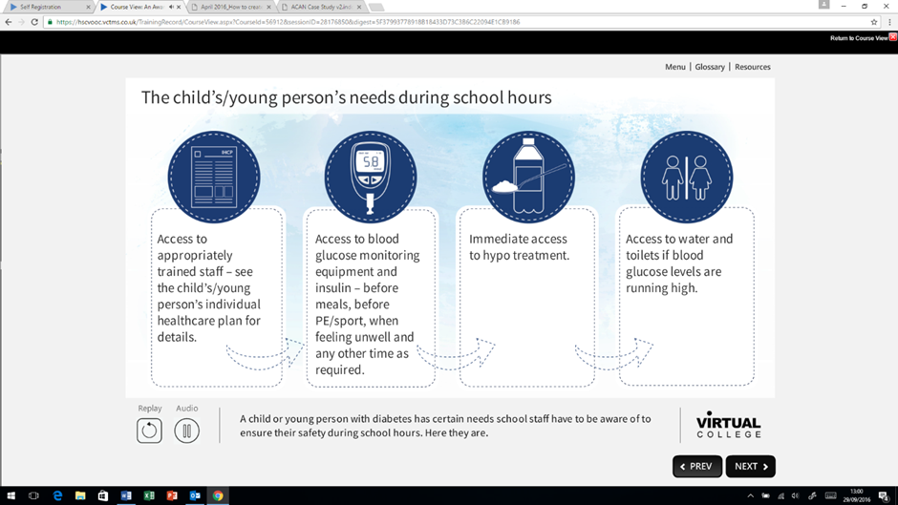
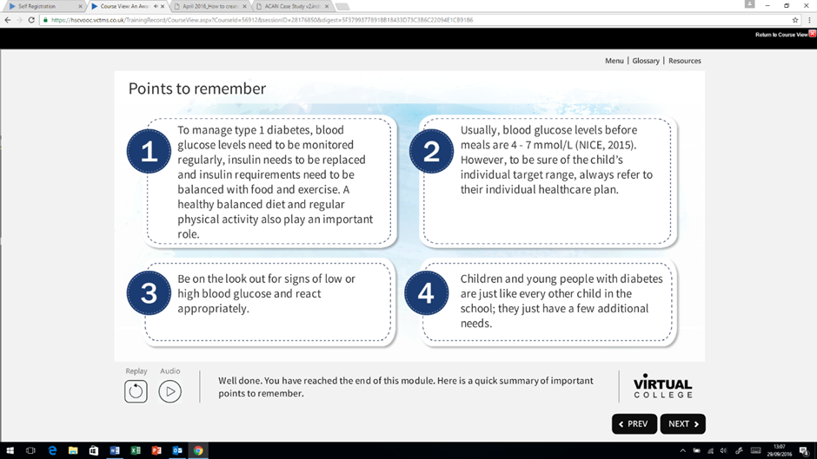
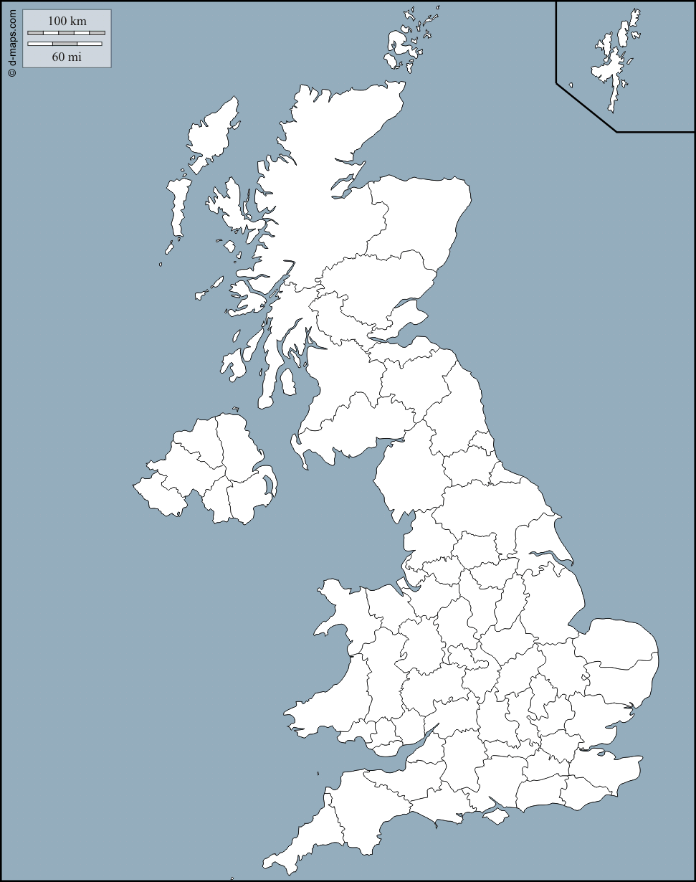
The development of an e-learning package to support education staff with the management of type 1 diabetes. M.G. Williams¹, C.L. Acerini², M.E. Carson³, J.E. Haest⁴, H. Nelson⁵, E. O'Hickey⁴, S. Singleton⁶, K. Wilson⁷
¹The Queen Elizabeth Hospital King’s Lynn NHS Foundation Trust, King’s Lynn. ²The Department of Paediatrics, Cambridge University, Cambridge. ³The North West of England Children and Young Peoples Diabetes Network. ⁴Oxford University Hospitals NHS Foundation Trust, Oxford. ⁵JDRF UK, London. ⁶Blackpool Teaching Hospitals NHS Foundation Trust. ⁷The East of England Children and Young Peoples Diabetes Network.
Currently in the UK children and young people with diabetes receive variable provision of care and support in educational settings. There are concerns that this impacts on the young person's glycaemic control, their quality of life, and their educational performance and outcome. Whilst most paediatric diabetes teams provide training for school staff, it may take several days, even weeks, after diagnosis before a diabetes educator is able to attend the school to provide education and support.
The aims of this project were to develop a comprehensive, consensus-based, e-learning package that would inform education providers about diabetes and provide a framework for the best practice management and support of young people with type 1 diabetes in schools. This package was not intended to replace the visit from the specialist nurse but to complement this and allow the young person to return to education at the earliest possible opportunity. This was achieved by convening a series of multi-agency stakeholder workshops including clinicians, patients/families, teachers, and voluntary sector representatives, to discuss the content and format that this package should take. These discussions were then developed into two e-learning modules (basic and advanced) by a core team of diabetes educators from 3 regional diabetes networks.
The modules provide guidance to all key parties involved in the day to day support of young people with diabetes, including expected roles and responsibilities, and legal obligations. The basic module is aimed at all staff to raise their general awareness of type 1 diabetes. The advanced module is for those staff designated specific responsibilities for supporting the young person with type 1 and goes into greater depth regarding the management and treatment of diabetes in the school setting. These modules have been positively received by education providers, and are endorsed by the National Children and Young Person's Diabetes Network.
Why is the e-learning package needed?
ISPAD (2000)¹ state that education is a cornerstone of childhood, and diabetes should not alter a child’s ability to achieve in school. However, this is reliant upon appropriate and effective care, not only from parents and carers, but also from other agencies including colleges, schools and early years settings.
Nationally there have been numerous anecdotal stories from parents highlighting the variability in standards of care for newly diagnosed children and young people (CYP) in schools. Several factors may cause this:
It may take several days, even weeks, after diagnosis before an educator is able to attend the school to provide education and support.
Inconsistent training nationally.
Staff not having adequate knowledge.
This could lead to:
Delays for the CYP returning to school after diagnosis.
Variable levels of care and support provided whilst at school and the potential for this to impact upon glycaemic control, their quality of life, and their educational performance.
The package is not intended to replace the visit from the educator but to complement this and allow the CYP to return to education at the earliest possible opportunity.
CYP spend a large proportion of their formative years in school. Therefore it is essential that those with diabetes have access to safe care, promoting optimal diabetes management, and reducing the short and long term risk of complications. Thus it was decided to formulate a consensus based e-learning package that was accessible for all education staff, providing a framework for the best practice management and support of CYP.
Development of the e-learning package
The package was developed by convening a series of multi-agency stakeholder workshops (attended by clinicians, patients/families, teachers, and voluntary sector representatives) to discuss the potential content and formats. The key points raised were used by diabetes educators from 3 regional diabetes networks to form the basis of the two e-learning modules (basic and advanced). Funding secured from JDRF and The National Lottery Awards for All enabled the development of the package by Virtual College, who have a proven track record of e-learning across multiple sectors.
The modules provide guidance to all key parties involved in the day to day support of young people with diabetes, including expected roles and responsibilities, and legal obligations. Learning is enhanced through the use of text, images, cartoons/films, multiple choice questions based on scenarios, and narration.
The basic module: aimed at all staff to raise their general awareness of type 1 diabetes, can be completed individually or in groups e.g. staff meetings.
Content includes:
What is diabetes.
Hypoglycaemia and hyperglycaemia signs and symptoms and their treatments
How sub-optimal management can affect the CYP both physically and cognitively.
The advanced module: for those staff with designated specific responsibilities for supporting the CYP as it goes into greater depth regarding the management and treatment of diabetes.
Content includes:
How to monitor blood glucose levels
Insulin administration.
Management of exercise.
Advice regarding school trips and residentials.
Following publication Virtual College added the package to its Patient Safety Suite and has publicised it widely in its regular mail shots and emails to education settings.
A
B
C
Screenshots from package
The child’s/young person’s needs during school hours (basic module)
What is type 1 diabetes (film, basic module)
Points to remember (basic module)
Results and next steps
Cumulative totals per area
(Basic and advanced module registrations
up to 28/09/2016)
Scotland including islands
74
Northern Ireland
55
71
97
43
85
43
218
270
67
Total: 5468
Breakdown by profession
Secondary Education 25.8%
Primary Education 18.5%
Healthcare 13.4%
Early Years Education 12.7%
Other 11.4%
Children’s Social Care 9.2%
Further Education 8.5%
University 0.5%
88
99
242
92
117
125
72
196
35
309
Wales
32
52
254
33
168
91
14
62
108
86
33
128
34
56
59
50
385
448
60
86
88
158
103
72
139
107
26
92
30
8
Data provided by Virtual College
Uptake of the free to access package has exceeded expectations, with 5468 registrations across multiple professions. Further steps are needed to maximise uptake and to increase the level of care and support offered in educational settings.
An assessment of the efficacy of the package is also required. Next year a parental satisfaction survey will be published on the various regional network Facebook pages and websites. A separate survey will be sent via Virtual College to all registered users to assess their knowledge level. Results of both of these surveys will be used to inform future package updates.
References
¹International Society of Paediatric and Adolescent Diabetes (ISPAD 2000). Consensus guidelines for the management of type 1 diabetes mellitus in children and adolescents.
For further details please see https://jdrf.org.uk/school-pack/schools-e-learning-module/

