Slide 1
Endobarrier treatment at SWBH – some real patients
These patients have given permission for these images to be shared
They are typical

Slide 2
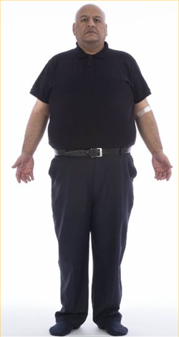
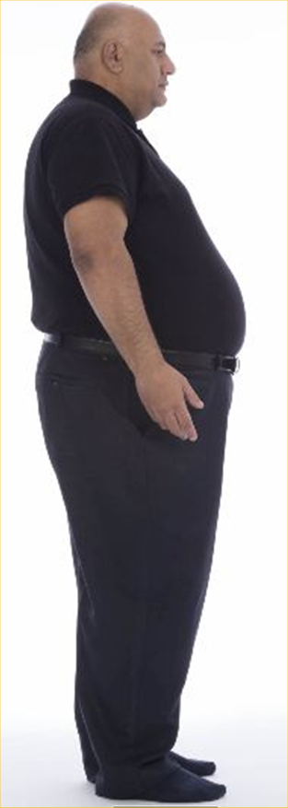
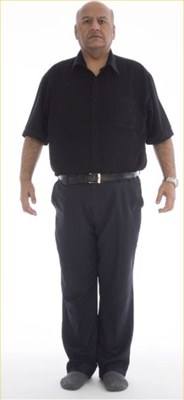
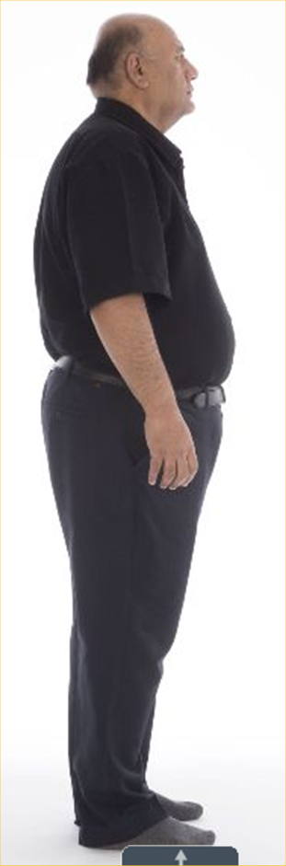
Before
12 months After
HbA1c 12.1%
Weight 136.9 kg
BMI 44.7 kg/m²
HbA1c 7.5%
Weight 115.0 kg
Weight loss 21.9 kg (48.2 pounds)
BMI 37.6 kg/m²

Slide 3
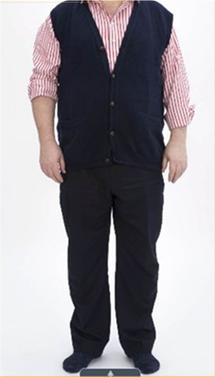



Before
12 months After
HbA1c 9.2%
Wt = 105.6 kg
BMI = 35.3 kg/m²
Insulin 100 units
HbA1c 5.8%
Weight 80.0 kg
Weight loss 25.6 kg (56.3 pounds)
BMI 26.7 kg/m²
Insulin no longer required

Slide 4

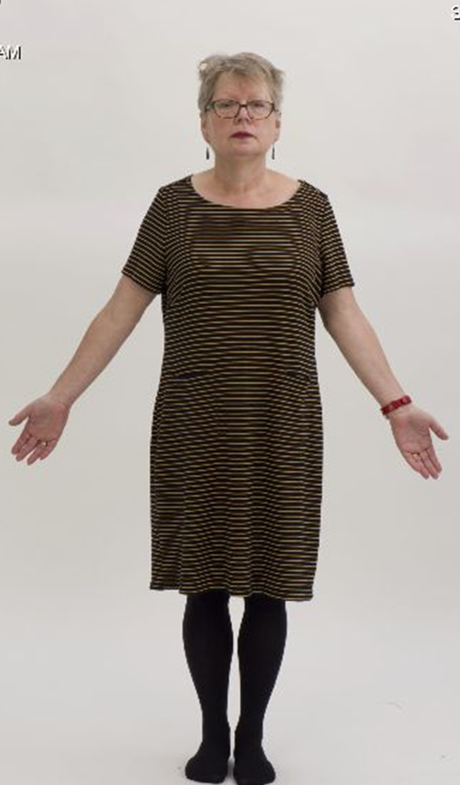
Before
12 months After
HbA1c = 7.7%
Wt = 86.6 kg
BMI = 35.1 kg/m²
Obstructive sleep apnoea requiring CPAP
HbA1c = 6.1%
Wt = 65.6 kg
weight loss = 21.0kg (46.2 pounds)
BMI = 26.2 kg/m²
CPAP no longer required

Slide 5
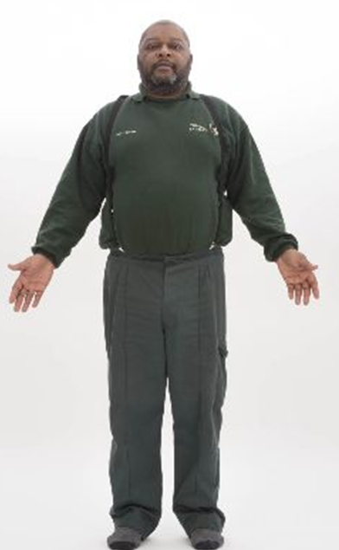

Before
12 months After
HbA1c = 9.1%
Wt = 116.4 kg
BMI = 38.0 kg/m²
Insulin 26 units daily
Idiopathic interstitial pneumonitis requiring ambulatory oxygen therapy
HbA1c = 6.6%
Wt = 88 kg
Weight loss 28.4 kg (62.5 pounds)
BMI = 28.8 kg/m²
Insulin no longer required
Ambulatory oxygen therapy no longer required

Slide 6


Before
12 months After
HbA1c = 8.6%
Wt = 82.9 kg
BMI = 33.6 kg/m² (Obese BMI)
HbA1c = 6.8%
Wt = 62.2 kg
Weight loss 20.7 kg (45.5 pounds)
BMI = 24.7 kg/m² (Normal BMI)

