Slide 1
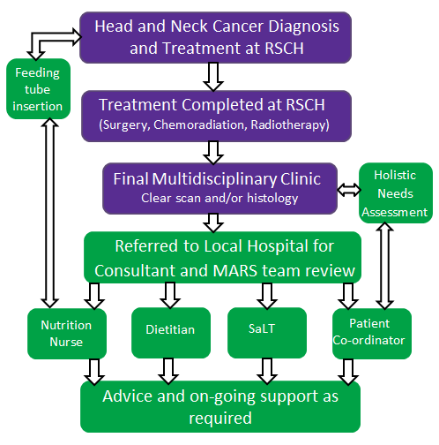
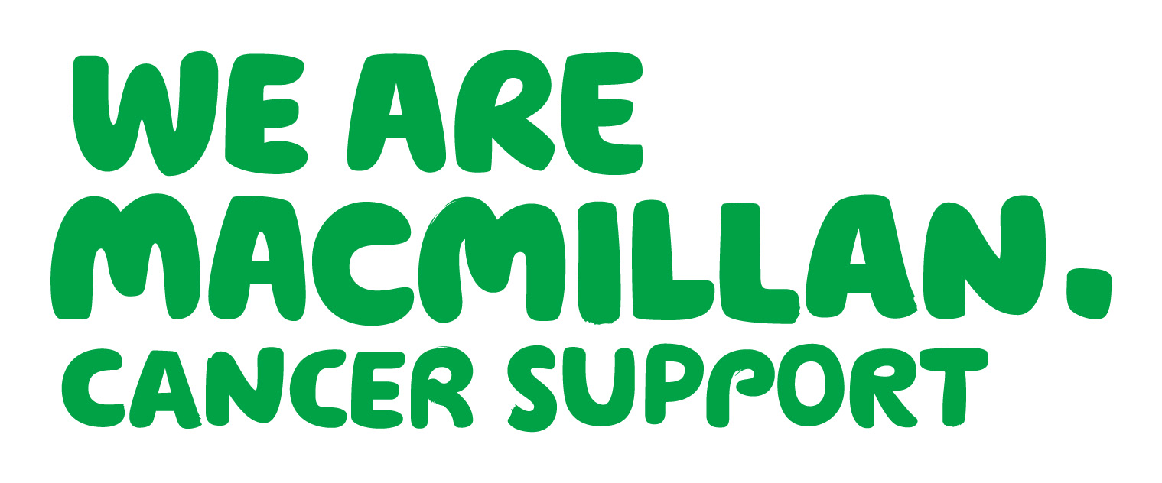
Establishing a Multidisciplinary
Head and Neck Cancer Rehabilitation Service
Anna Clayton, Kate Edwards, Claire Hanika, Karen Matthews,
Emma Papworth, Elizabeth Seymour, The Royal Surrey County Hospital
Egerton Road, Guildford, Surrey, GU2 7XX England
Background
The 2004 NICE IOG for Head & Neck Cancer⁽¹⁾ (HNC) states; “every Cancer Centre which deals with patients with head and neck cancer should establish a local support team which will provide services within a defined geographical area”. External peer review identified a lack of on-going support to H&NC patients within Surrey and North Hampshire. The Macmillan Aftercare and Rehabilitation Service (MARS) was developed to address this deficiency.
Overview of the support offered by MARS
Discussion
Implementation of the MARS has enabled patients’ to reduce both reliance and length of time on oral nutritional supplements and enteral feeding.
Of the 37 patients’ supported by the MARS dietitians, 9 had their feeding tubes removed and a further 7 were weaning from their feeding tube. A further 15 feeding tubes were removed by MARS nutrition nurses following patients treatment at RSCH. Nutrition nurse intervention has allowed more timely removal of feeding tubes.
56 patients prescribed oral nutritional supplements have been assessed, of which 26 had their supplements reduced following input from MARS, 21 stopping supplements completely.
SVR valve changes and support are being provided in a more timely and cost effective manner closer to patients homes. Videofluoroscopies have identified patients at risk of dysphagia, enabling appropriate management and reducing risks of associated complications (e.g. Chest infections and malnutrition).
Wider support services, such as smoking cessation and support with finances are more readily available to patients.
A focus group has been run by the MARS patient co-ordinator to establish a baseline of patient experience.
Patient and professional feedback to the service has been very positive:
Nutrition Nurse | Dietitian | Speech & Language Therapist | Patient Co-ordinator
Post gastrostomy placement advice | Food fortification and oral nutritional supplements | Laryngectomy support including Surgical Voice Restoration (SVR) management | Support with benefits/Macmillan grant applications
Tube and tube site troubleshooting | Enteral feeding advice | Swallow assessment (in clinic and via videofluoroscopy) | Holistic Needs Assessment
Tube replacement | Healthy eating and lifestyle advice | Dysphagia management including texture modification | Smoking Cessation advice
Tube removal | Weight reduction and other disease specific dietary advice | Speech therapy and onward referral to voice specialist as required | Signposting to support services
Survivorship advice and referral to other services as required
Aims
The MARS team aims to provide a high quality accessible multidisciplinary rehabilitation service for HNC patients in line with the NCAT guideline: Cancer Rehabilitation: Making excellent cancer care possible (2013).
The objectives of the service are to provide:
Advice, support and exercises for Speech and Swallowing problems
Advice and support on all aspects of nutritional intake
Support to decrease reliance on oral and enteral nutritional supplementation
Help with feeding tube care
Support and advice following a laryngectomy or tracheostomy
Support in managing the side effects of cancer treatments
Emotional support for patients and their families and carers
Results
The MARS team supported 287 individual patients during the first 8 months of service (May-December 2013).
Patient feedback:
“I wish I had this service immediately after treatment.”
“Excellent service, 10 out of 10! We really appreciate the support”
“We could have done with this
(service) 4 years ago”
“It’s really good to have more
support near home”
Methods
The MARS team comprises Band 7 Dietitians, Speech and Language Therapist (SaLT), Nutrition Nurses and a Band 4 Patient Co-ordinator, employed by the Royal Surrey County Hospital (RSCH).
The team was funded by Macmillan for year 1 of service, with year 2 funding secured 75% from NHS England and 25% by Macmillan.
Multi-professional clinics have been established alongside established consultant clinics at five local acute hospitals. The referral and treatment pathway for MARS is below:
Future areas of work
In year 2 of the service the MARS team plan to establish a survivorship program for people with Head & Neck Cancer.
The MARS team are piloting outcome measures to assess patient reliance on enteral feeding and oral nutritional supplements, speech intelligibility and levels of dysphagia.
Duration of tube feeding will be audited against data prior to MARS.
Conclusions
The MARS team has supported patients with proactive management of nutritional, laryngectomy and feeding tube-related issues. Additionally survivorship, voice support, lifestyle and healthy eating support have been beneficial in improving patients quality of life and aftercare experience.
During the first 8 months of the Macmillan Aftercare and Rehabilitation Service clinical benefits to patient experiences and outcomes have been demonstrated.
The service continues to develop to meet the evolving needs of patients with Head & Neck Cancer.
Acknowledgements
The MARS team would like to acknowledge the support from the Head and Neck Multidisciplinary Team at the Royal Surrey County Hospital, Head and Neck Clinical Nurse Specialists across Surrey and North Hampshire and Macmillan Cancer Support
References:
National Institute for Health and Care Excellence (2004) Improving Outcomes Guidance for Head and Neck Cancer, London, NICE
Cancer Rehabilitation. Making excellent cancer care possible (NCAT 2013)

