Slide 1
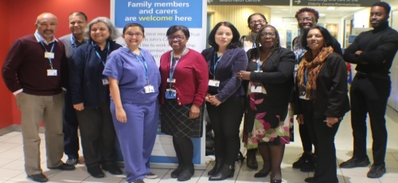

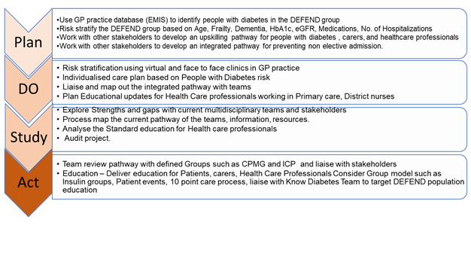
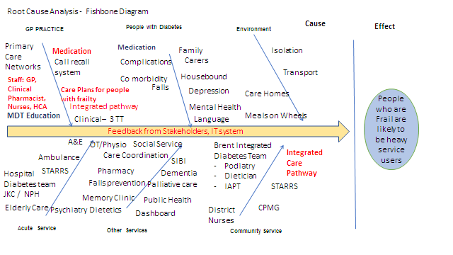
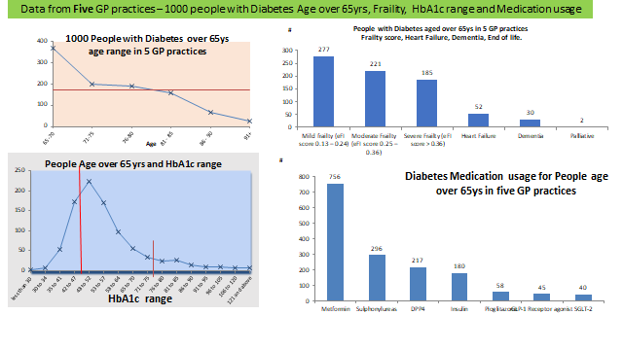
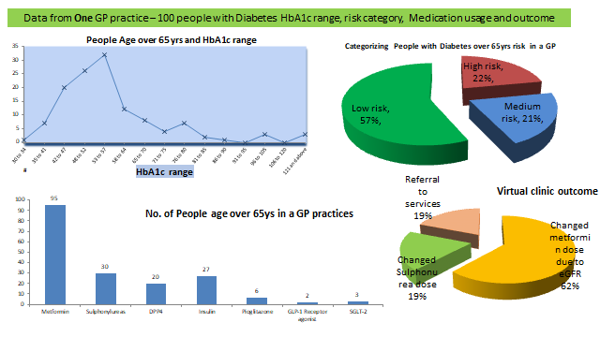
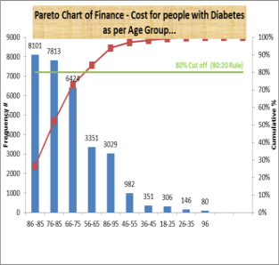
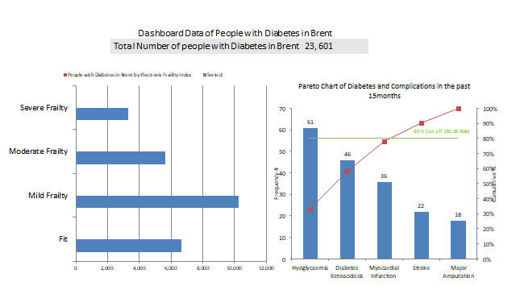
People with Diabetes who are Elderly Frail, End of Life and Dementia are likely to be high service users
By Anganie Seecharan, Elsa Muhammad, Geeta Karmacharya, Julia Anthony Nina Patel, Noel Farine, Dr Koteshwara Muralidhara
Sponsor – Margaret A McLennan - Head of Pathways/BIDS), Dr Koteshwara Muralidhara - Consultant Physician in Endocrinology & Diabetes, Integrated Medicine Directorate
Team Photo
Team BIDs says Yes to DEFEND for People with Diabetes who are Elderly Frail, End of Life and Dementia
Aim
Why is this important to service users and carers?
PDSA- Improvement Idea
-Improve diabetes care for the DEFEND population
-Stratify and reduce risks for hypoglycaemia, hyperglycaemia, and unplanned hospitalisation
-Integrate service pathways to create a multidisciplinary care approach for better patient care, experience, and outcome
-Upskill patients, family, carers, and
health care professionals in Diabetes Management for DEFEND populations’
Learn to Self Manage diabetes to reduce risks.
Impact on financial costs and service’s hence to enable the right care at the right time
For all stakeholders to support a seamless integrated working environment, in providing individualised care. and promote well being.
Education for people with Diabetes, family, carers and heath care professionals to enable efficient and effective care .
Root Cause analyses: Fishbone
Data
Learning and What next?
Work with other stakeholders like CPMG, ICP, PCNs: virtual clinics, care planning, and Develop functional integration pathways that is user friendly
Have planned PDSA cycles to improve services
Audit - Learn from data for individual and population level care planning: use dashboard, user surveys.
Type of Education : Develop and deliver learning modules for patients and carers, and healthcare professionals

Slide 2
Improvement opportunities
Plan
DO
Study
Team review pathway with defined Groups such as CPMG and ICP and liaise with stakeholders
Act
Explore Strengths and gaps with current multidisciplinary teams and stakeholders
Plan Educational updates for Health Care professionals working in Primary care, District nurses
Process map the current pathway of the teams, information, resources.
Analyse the Standard education for Health care professionals
Use GP practice database (EMIS) to identify people with diabetes in the DEFEND group
Risk stratify the DEFEND group based on Age, Frailty, Dementia, HbA1c, eGFR, Medications, No. of Hospitalizations
Liaise and map out the integrated pathway with teams
Work with other stakeholders to develop an upskilling pathway for people with diabetes , carers, and healthcare professionals
Work with other stakeholders to develop an integrated pathway for preventing non elective admission.
Education – Deliver education for Patients, carers, Health Care Professionals Consider Group model such as Insulin groups, Patient events, 10 point care process, liaise with Know Diabetes Team to target DEFEND population education
Risk stratification using virtual and face to face clinics in GP practice
Individualised care plan based on People with Diabetes risk
Audit project.

