Slide 1
Diabetes Competencies
Angela Hargreaves
Dietetic Team Leader – Diabetes and Behaviour Change
OCDEM
Churchill Hospital
Oxford OX3 7LJ
angela.hargreaves@ouh.nhs.uk
Pamela Dyson
Research Dietitian
University of Oxford
OCDEM
Churchill Hospital
Oxford OX3 7LJ
pamela.dyson@ocdem.ox.ac.uk

Slide 2
Diabetes Competencies: Aims
To provide training for non-diabetes specialist dietitians to ensure they meet the relevant competencies for their employment band

Slide 3

Competency Framework 2011
Written and published in 2011¹
Lists 17 separate competencies
Each competency matched to a specific NHS band
Assessment recommended²

Slide 4
List of competencies
Pathophysiology, epidemiology and clinical diabetes guidelines
Teaching and learning skills
Individualised self-management education
Psychosocial and behavioural approaches
Group-based structured education
Principles of medical nutrition therapy
Short-term complications
Specific nutrition related needs of children and adolescents
Co-morbidities
Specific nutrition related needs in gestational diabetes and pregnancy
Specific nutrition related needs of older adults
Specific nutrition related needs of people from ethnic groups
Eating disorders
Coeliac disease
Prescribable diabetes medication
Evaluation and research
Team, programme and business management

Slide 5
List of competencies – Session 1
Pathophysiology, epidemiology and clinical diabetes guidelines ✔
Teaching and learning skills
Individualised self-management education
Psychosocial and behavioural approaches
Group-based structured education
Principles of medical nutrition therapy ✔
Short-term complications
Specific nutrition related needs of children and adolescents ✗
Co-morbidities
Specific nutrition related needs in gestational diabetes and pregnancy ✔
Specific nutrition related needs of older adults ✔
Specific nutrition related needs of people from ethnic groups ✔
Eating disorders ✔
Coeliac disease ✔
Prescribable diabetes medication
Evaluation and research ✗
Team, programme and business management ✗

Slide 6
Diabetes competencies
Section 1. | Pathophysiology, epidemiology and clinical guidelines

Slide 7
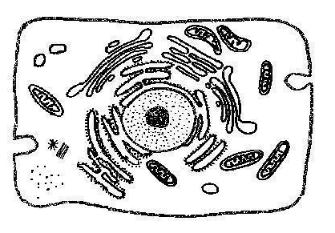
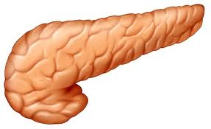
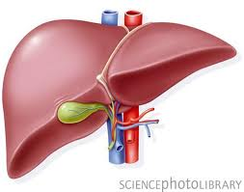


Physiology of normal glucose metabolism
INSULIN
Cells use
glucose
for energy
Pancreas releases insulin
Liver converts
glucose to
glycogen
>8 mmol/l
Excess glucose
stored as fat
Homeostatis: normal blood glucose
3.5-7.8 mmol/l
<3.5 mmol/l
Liver
releases
glucose
Pancreas
releases
glucagon
GLUCAGON

Slide 8
Pathophysiology of type 1 diabetes
✗
INSULIN
✗
Cells cannot
use glucose
for energy
Adipose tissue is utilised for
energy leading to production
of ketones and DKA
Liver cannot
convert glucose to glycogen
>8 mmol/l
Excess glucose
cannot be
stored as fat
Homeostatis: normal blood glucose 3.5-7.8 mmol/l
Blood glucose
rises
<3.5 mmol/l
Liver
releases
glucose
Pancreas
releases
glucagon
GLUCAGON

Slide 9
Pathophysiology of type 2 diabetes
REDUCED
INSULIN
SECRETION
Cells use
some glucose
for energy
Pancreas releases
some insulin
INSULIN
RESISTANCE
Liver converts
some glucose to
glycogen
>8 mmol/l
INCREASED
LIVER
GLUCOSE
Excess glucose
stored as fat
Homeostatis: normal blood glucose 3.5-7.8 mmol/l
Blood glucose
rises
<3.5 mmol/l
Liver
releases
glucose
Pancreas
releases
glucagon
GLUCAGON

Slide 10
Types of diabetes mellitus
Type 1
Type 2
Gestational diabetes
Genetic forms of diabetes e.g. Maturity-onset diabetes of the young (MODY)
Secondary diabetes

Slide 11
Type 1 and type 2 diabetes
 | Type 1 (10-15%) | Type 2 (85-90%)
Onset
Effect
Causes
Treatment
Usually sudden
Gradual
β-cell failure leading to total loss of insulin production
Insulin resistance and progressive β-cell failure
Autoimmune disease,
genetic factors
Obesity, physical
inactivity,
genetic factors
Insulin and diet
Diet, exercise, medication, weight loss

Slide 12
Epidemiology: global diabetes prevalence 2015
415 million
9%
1 in 2 remain
undiagnosed
Source: IDF Atlas 2015³

Slide 13
Diabetes prevalence in the UK 2015
Country | Prevalence (%) | Numbers
England | 6.2 | 2,913,538
Northern Ireland | 5.3 | 84,836
Scotland | 5.9 | 271,312
Wales | 6.9 | 183,348
Total | 6.2 | 3,453,034
Source: Facts and Stats, Diabetes UK 2015⁴

Slide 14
Referrals for care and education - groups
Education programme | Description | Refer to:
Diabetes2gether (D2G) | Education programme for people with Type 2 diabetes (aimed at newly diagnosed) | Community DSN
Diabetes4ward (D4W) | Education programme for people with Type 2 diabetes (aimed at follow on from D2G) | Community DSN
Insight | Carb counting and insulin adjustment course (similar to DAFNE). Includes management of hypos, alcohol, exercise, illness. Offered 9 months after diagnosis | OCDEM – patient to be given leaflet and to contact us
Carbohydrate workshop | Carb and insulin adjustment workshop without additional management strategies of Insight | OCDEM – patient to be given leaflet and to contact us
Advanced carbohydrate workshop | Refresher for people who are already carb counting and adjusting insulin doses | OCDEM – patient to be given leaflet and to contact us
Weight management group | For people with type 1 or 2 diabetes to assist with weight management and diabetes control | Complex diabetes weight management service
Pre-conception group | Group to promote good glycaemic control, correct folic acid dose and food safety advice pre-pregnancy for type 1 and 2 diabetes | OCDEM DSN

Slide 15
Referrals for care and education - individuals
OCDEM
Newly diagnosed type 1 diabetes
Blood glucose management/carbohydrate awareness
Gastroparesis
Pregnancy
Complex diabetes weight management service
Conversion to insulin
Weight management for people on complex medication
Carbohydrate awareness
Community
Newly diagnosed type 2 diabetes unsuitable for groups
Nutritional support (collaborating with community DSNs)
Weight management (BMI 25-30 kg/m², non-complex meds)

Slide 16
Clinical practice guidelines
Clinical care:
Type 1 diabetes
NICE. Type 1 diabetes in adults: diagnosis and management (NG17). NICE: London; August 2015⁵
Type 2 diabetes
NICE. Type 2 diabetes in adults: management (NG28). NICE: London; December 2015⁶
ADA/EASD Position statement on management of hyperglycaemia in type 2 diabetes⁷

Slide 17
Clinical targets
 | Type 1 diabetes | Type 2 diabetes
HbA1c
Blood pressure
Lipids
<48mmol/mol (6.5%)
Individual targets: 48-59mmol/mol (6.5-7.5%)
<135/80
<130/80 for those with
abnormal albumin excretion
or >2 features of MES
<140/80 in the absence
of complications
<130/80 with complications
Therapy should be offered to:
>40 years
>10% risk of CVD
established nephropathy
other CVD risk factors
Therapy should be offered to:
>10% risk of CVD assessed by QRISK2 tool
Source: NICE guidance ^{5-6,8}

Slide 18
Local policies and procedures
New type 1 care pathway
Initial dietary education before discharge from ward or within one week of diagnosis
Responsibilities of ward dietitians
Reassure patients that no foods need exclusion
Take diet history to ensure some carbohydrate included at each meal
Explain that replacing sugary drinks and avoiding large amounts of sugary food will produce short-term benefit

Slide 19
Diabetes Competencies
Section 6. | Medical nutrition therapy

Slide 20

Diabetes UK guidelines
Published in 2011⁹
Guidelines are graded from A-D, using NICE criteria

Slide 21
Management of diabetes
Recommendations for macronutrients
Glycaemic control of Type 1 and Type 2 diabetes
Weight management
Special considerations:
Pre-conception, gestational diabetes and pregnancy
Older adults
Ethnic groups
Eating disorders
Coeliac disease

Slide 22
Macronutrients
Carbohydrate: There is no evidence for a recommended amount of carbohydrate for people with type 1 and type 2 diabetes
Fat: Saturated fat should be replaced with unsaturated fat, but there is little evidence for exact proportion of energy from total fat
Protein: No evidence for specific recommendations

Slide 23
Glycaemic control and type 1 diabetes
Carbohydrate is the main nutritional consideration for individuals with Type 1 diabetes (A)
People using MDI and CSII benefit from adjusting insulin to carbohydrate intake and should be offered education to support this (A)
Consistent quantities of carbohydrates on a day-to-day basis are beneficial for those individuals on fixed insulin regimens (C)
Increased physical activity offers health benefits although there is no evidence of benefit in glycaemic control (A)

Slide 24
Glycaemic control and type 2 diabetes (1)
Weight management should be the primary nutritional strategy in managing glucose control in Type 2 Diabetes for those who are overweight and obese (A)
Regular moderate physical activity can reduce HbA1c by 5 -7mmol/mol (0.45 – 0.65%) independent of weight loss (A)
Focus should be on total energy intake intake rather than the source of energy in the diet (macronutrient composition) for optimal glycaemic control (A)

Slide 25
Glycaemic control and type 2 diabetes (2)
Total amount of carbohydrate is a strong predictor of glycaemic response and monitoring intake, whether by use of exchanges, portions or experience-based estimation, remains a key strategy in achieving glycaemic control (A)
Low GI diets reduce HbA1c by 2mmol/mol (0.14%)(A)

Slide 26
Carbohydrate management
Total carbohydrate content of meals and snacks is a consistent predictor of postprandial glucose concentrations
10g carbohydrate raises blood glucose levels by 2-3 mmol/l
In terms of glycaemic control, carbohydrate is the major nutritional consideration

Slide 27
Carbohydrate awareness and budgets
Carbohydrate awareness is the process of identifying sources of carbohydrate in the diet
Knowledge of carbohydrate-containing foods in isolation is not effective for blood glucose control
Carbohydrate awareness can only be effective in terms of glycaemic control when accompanied by some knowledge of portion size – carbohydrate budgets/carbohydrate counting

Slide 28
Carbohydrate awareness in practice
Various tools can be used to promote carbohydrate awareness:
Food lists
Food models
Food quizzes

Slide 29
Is carbohydrate awareness enough?
Carbohydrate awareness supports identification of foods that raise blood glucose levels
Postprandial blood glucose tests can provide useful information about the effects of food
People with diabetes treated by diet alone, with oral hypoglycaemic agents, with fixed insulin doses or those wishing to lose weight will need advice about portion sizes
Carbohydrate budgets or allowances can be used, but there is no evidence to support carb counting

Slide 30



Carbohydrate budgets - exchanges
Balancing your blood
glucose with a
carbohydrate plan
Prescriptive
Requires numeracy and literacy
Can be complicated
No evidence of benefit

Slide 31
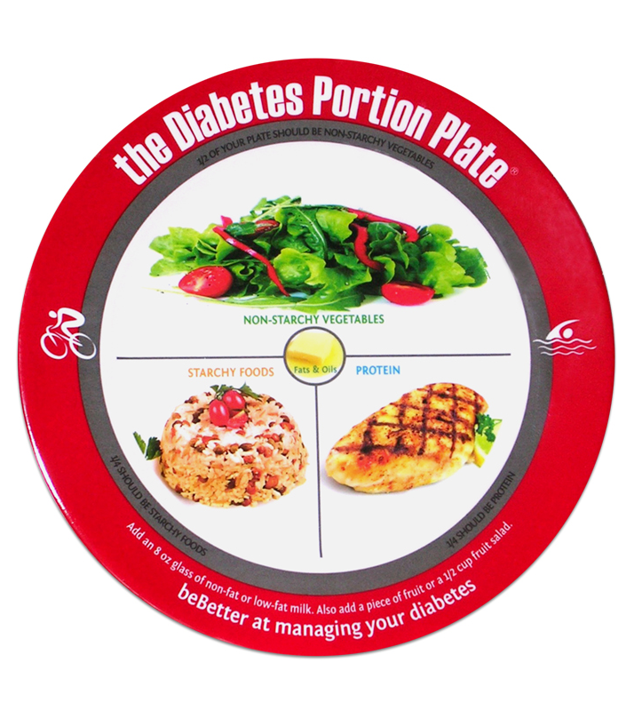
Carbohydrate budgets – food plates
Limited evidence of effect
Useful for main meals
Issues with practicality

Slide 32
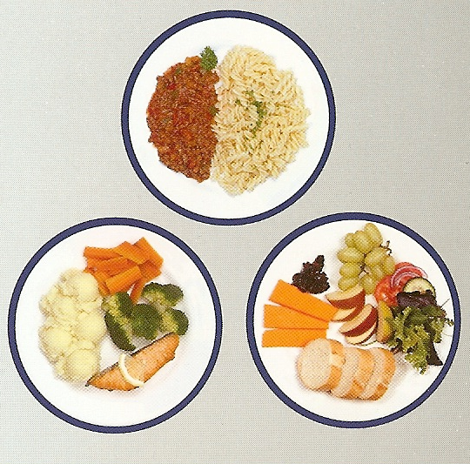
Carbohydrate budgets – 50g portions
Useful for visual learners
One-size-fits-all is not appropriate
Prescriptive

Slide 33

Zimbabwe hand jive
Vegetables:
2-3 servings
daily
Starchy carbs:
3 servings
daily
Protein:
2 servings
daily
Fruit:
2 servings
daily
Fats and oils:
3 servings
daily

Slide 34
Glycaemic index and glycaemic load
Definitions:
The glycaemic index is a scale that ranks carbohydrate foods by how much they raise blood glucose levels compared to a reference food
The glycaemic load is a scale that ranks carbohydrate food by the effect they have on blood glucose levels in terms of both GI and amount eaten

Slide 35
Advantages and disadvantages of GI
Advantages:
Lowers HbA1c by 2mmol/mol (0.14%)¹⁰
Disadvantages:
No significant differences for body weight, insulin resistance or cardiovascular risk in people with type 2 diabetes¹⁰
Qualitative rather than quantitative
Low GI choices may not be the healthiest
Other factors affect GI of a food (vinegar, cheese, nuts)
Reinstates a prescriptive approach

Slide 36
GI and GL - summary
Low GI diets have a small but significant effect on HbA1c
NICE guidance does not recommend low GI diets for those with type 1 diabetes
There is no evidence of benefit for weight management or cardiovascular risk
The amount of carbohydrate, rather than the type, is a consistent predictor of postprandial blood glucose levels
Low GI diets may be useful in providing a modest additional effect of glycaemic control, but are not recommended as a primary strategy

Slide 37
Weight management
Lowest rates of mortality and morbidity are associated with BMI 18.5 – 24.9kg/m² ¹¹
Weight loss is a key therapeutic goal for people with type 2 diabetes
There is little data or evidence for obesity rates and weight loss in people with type 1 diabetes

Slide 38
Weight management and type 2 diabetes
5-10% weight loss is associated with:
HbA1c reductions of 2-30mmol/mol (0.25–2.9%)
28% reduction in cardiovascular mortality
25% reduction in total mortality
30% reduction in proteinuria
Improvements in sleep apnoea, mobility, physical function, urinary incontinence, erectile dysfunction, depression and quality of life¹²

Slide 39
But…………….
The health benefits of weight loss for people with type 2 diabetes have long been recognised
Therapeutic weight loss is difficult to achieve
People lose weight over 4-6 months, then reach a plateau
Average weight losses range from 4-10%

Slide 40
Dietary strategies for weight loss
What is the most effective dietary strategy for people with type 2 diabetes?
Which strategies are available?

Slide 41
Dietary strategies for weight loss
Healthy eating
Low carbohydrate
Meal replacements
Very low energy diets (VLED)
Mediterranean diets
Low GI diets
Commercial groups – Weightwatchers, Rosemary Conley, Slimming World
Fast (5:2) diet
Fad diets – cabbage soup, grapefruit diet, egg diet
Strong evidence
of efficacy
No evidence of efficacy –
studies have been done
No evidence –
studies not done

Slide 42
Healthy eating
The majority of published studies have used this strategy
The Look AHEAD study is the largest and longest
5145 people with type 2 diabetes
Randomised to intensive lifestyle support or education and usual care
Medical management provided by own physician
Baseline characteristics: age 59 yrs, 40% male, weight 100.7kg, BMI 35.9 kg/², HbA1c 55mmol/mol (7.2%)
15% treated by insulin

Slide 43
Look AHEAD intervention
Personalised weight loss plans
Energy restriction: 1200-1800 kcal/day
<30% total fat (<10% saturated fat)
Liquid meal replacements offered
Individual menu plans designed
Recommended 175 min/week of moderate activity (10,000 steps/day)
Orlistat offered to those who failed to meet personal weight loss targets

Slide 44
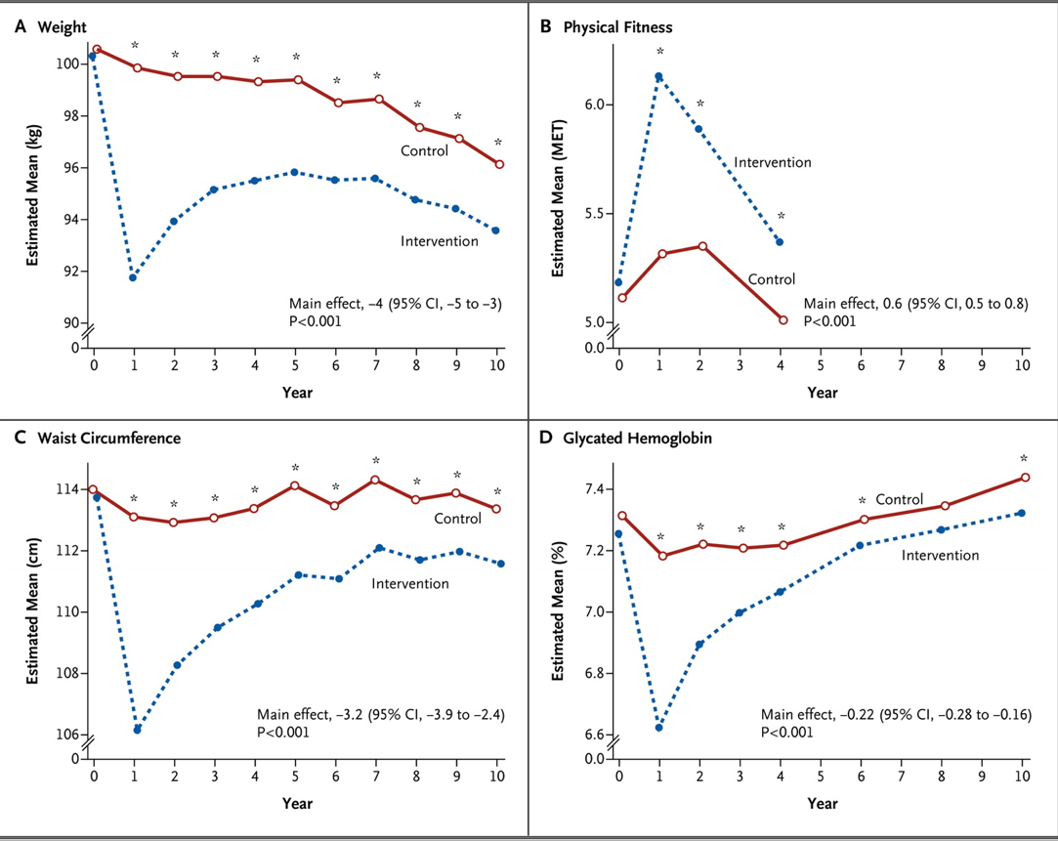
Look AHEAD results at 10 years
Look AHEAD Research Group, N Engl J Med 2013 ¹³

Slide 45
Low carbohydrate diets
Studies have shown that low carbohydrate diets in people with type 2 diabetes^{14,15}:
Reduce body weight by mean 4.8kg
Decrease HbA1c by 0.5% (6mmol/mol)
Have little or no effect on CVD risk factors, with a trend showing decrease in triglycerides by 2-3mmol/l
Low carbohydrate diets are effective – but do they demonstrate superiority?

Slide 46
Low carbohydrate diets
There is no evidence of superiority in terms of^{14,15}:
Weight loss
Glycaemic control
Cardiovascular risk

Slide 47
Mediterranean diets
A meta-analysis¹⁶ comparing Mediterranean diets to other dietary strategies reported significant differences (WMD) in:
Variable | WMD | P-value
Weight (kg) | -1.84 | <0.00001
HbA1c (mmol/mol/[%]) | -5 [-0.47] | <0.00001
Triglycerides (mmol/l) | -0.21 | <0.00001
HDL (mmol/l) | +0.04 | 0.004
LDL (mmol/l) | -0.08 | 0.34

Slide 48
Meal replacements
Based upon 2 meal replacements and 1 healthy, low fat meal/day
Short term results are significant:
Weight loss: 6.9 vs 4.3 kg
HbA1c: -19 v -13 mmol/mol (-1.7 v -1.2% )
Slim Fast has been shown to be effective in reducing weight (- 6 kg) and HbA1c (- 1%, 11mmol/mol)
Meal replacements were used as a strategy in the Look AHEAD trial

Slide 49
Very low calorie liquid diets (VLCLD)
Proprietary formula foods providing <1000 kcal/day¹⁷ or 450 – 800 kcal/day¹⁸
Must be used under medical supervision
In people with type 2 diabetes, VLCLD produce 3kg greater weight loss, and 13 mmol/mol (1.2%) greater reduction in Hba1c compared to a low calorie diet¹⁹
A small intervention study in 11 subjects reported diabetes remission in 73%²⁰, but longer term data from a larger study are awaited

Slide 50
Weight management case studies

Slide 51

Case study 1 – Muriel
Type 2 diabetes for 15 years
Weight 150 kg (24st)
BMI 55 kg/m²
Medication: Humulin M3 96/96 Metformin, Thyroxine, Bendrofluazide, Nifedipine, Fluoxetine, GTN spray
HbA1c 69 mmol/mol (8.5%)

Slide 52
Muriel –dietary intake
Breakfast | 2 toasted crumpets with low fat spread and Marmite 2 cups of tea with full-fat milk and sweetener I banana
Lunch | Sandwich made with wholemeal or granary bread, low fat spread and ham, tuna or chicken salad and low fat mayo. Snack-a-jacks. Fresh fruit. Diet Coke
Evening meal | Shepherd’s pie and peas/gammon and pineapple with baked pots and veg/roast with veg and roast pots/fish pie and mushy peas/low fat sausages, chips and baked beans. Jelly or diet yogurt
During the evening | Cheese sandwiches, biscuits, cakes, bread and butter, crisps, ice-cream, chocolate – binge-eating

Slide 53
Muriel – what had she tried?
At diagnosis – a prescriptive 1200 calorie diet
‘Healthy eating’ – a low fat, low sugar diet
Joining Weightwatchers
The Atkins diet
Slim-Fast
Increasing physical activity – walking more

Slide 54
What did Muriel choose?
A low fat diet
Calorie counting – 1200 calories/day
Increased physical activity – walking and gym sessions
Self-monitoring – food, exercise and blood glucose diaries
Problem-solving approach to binge-eating

Slide 55
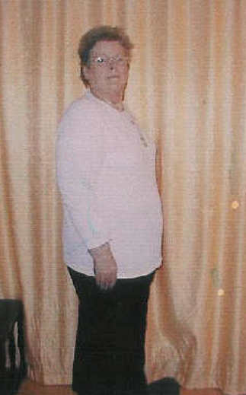
Muriel
Weight 102 kg (17 st)
BMI 37 kg/m²
Reduced insulin to 8 units at night
HbA1c 58 mmol/mol (7.5%)

Slide 56

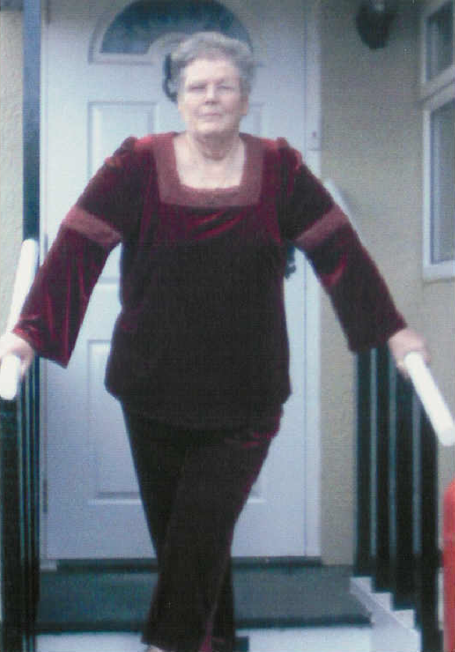
Muriel – before and after

Slide 57

Case study 2 - Andrew
Type 2 diabetes for 5 years
Weight 105 kg
BMI 34.2 kg/m²
Medication: Metformin and Simvastatin
HcA1c 72mmol/mol (8.7%)
Blood pressure 142/83

Slide 58
Andrew – dietary intake
Breakfast | Special K with full-cream milk and no sugar Tea with milk Weekends: bacon sandwich
Mid-morning | Coffee with milk Cake on special occasions (colleague’s birthday)
Lunch | In canteen: Shepherd’s pie, chips and baked beans/spaghetti bolognese/macaroni cheese and tomatoes/roast dinner/curry and rice/sausage, egg and chips Pudding: sponge pudding/fruit pie or crumble, custard
Evening meal | Chinese or Indian take-away Burger or fish and chips Supermarket ready meal. 3-4 bottles of lager

Slide 59
Andrew – what did he do?
Joined Weightwatchers on-line
Found that he was still able to eat the foods he enjoyed and that were available from the canteen at work and he used low fat ready meals at home
He joined the gym and began aerobic exercise twice weekly

Slide 60
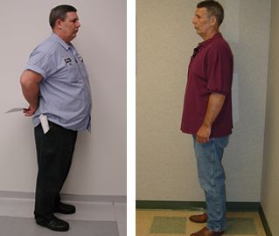
Andrew
Weight 85 kg
BMI 27.6 kg/m²
HbA1c 49 mmol/mol (6.6%)
Stopped Metformin (now diet alone)
Continued with stain therapy
Blood pressure 135/78

Slide 61
Andrew – before and after

Slide 62

Case study 3 - Rob
Weight 103 kg
BMI 32.3 kg/m²
Type 1 diabetes
Insulin regimen: 32 units Glargine, 12-16 units Novorapid tds
HbA1c 55 mmol/mol (7.2%)
Normal blood pressure and lipid levels

Slide 63
Rob – dietary intake
Breakfast | Fruit juice, bran flakes with banana and milk, wholemeal toast, Olivio & low sugar marmalade, tea
Mid-morning | Apple or 2 Rich Tea biscuits
Lunch | Sandwiches with 4 slices bread and tuna, ham or chicken salad, low fat crisps, diet yogurt, cereal bar, fresh fruit
Mid-afternoon | Scone or crumpet
Evening meal | Pasta and bolognese sauce/stir fried chicken and veg with noodles/grilled fish and salad and pots/curry and rice/chilli con carne and rice and salad. Sugar-free jelly, fruit canned in juice, low fat ice-cream
During evening | Low fat crisps, go-ahead biscuits, toast, crumpets, scones and beer, lager or wine at weekends

Slide 64
Rob – what did he do?
Completed the Insight course facilitating carbohydrate counting and insulin adjustment
Cut out all snacks between meals
Reduced portion sizes at meal times by approximately 25-30%
Started football training

Slide 65

Rob
Weight 90 kg
BMI 26 kg/m²
Insulin regimen:
Glargine 25 units od
Novorapid I unit for every 10g CHO
HbA1c 53 mmol/mol (7.1%)

Slide 66
Rob – before and after

Slide 67

Case study 4 -Sandra
Weight 81 kg
BMI 30.1 kg/m²
Newly diagnosed type 2 diabetes
HbA1c 62 mmol/mol (7.8%)
No medication
Blood pressure and lipid levels within normal range

Slide 68
Sandra – dietary intake
Breakfast | Fruit juice or grapefruit. Grilled bacon and tomatoes/scrambled eggs on toast/baked beans on toast/low fat sausages and mushrooms. Black coffee
Mid-morning | Black coffee
Lunch | Egg, chicken, tuna or cold meat salad with baked pot or crusty bread/home-made soup and bread/sandwiches with cold meat, tuna, salmon salad Fruit or diet yogurt
Evening meal | 2 glasses red or dry white wine, peanuts/crisps Lean meat, chicken or fish with pots/pasta/rice and veg or salad. Sorbet/fruit pudding/mousse/gateau 3-course meal at weekends

Slide 69
Sandra – what did she do?
Decided to adopt a low carbohydrate (<50g/day) diet
Avoided all foods containing sugar and starch, obtained carbohydrate from fruit, vegetables and milk products
Was able to continue entertaining and eating the foods she enjoyed

Slide 70

Sandra
Weight 71.7 kg
BMI 26.6 kg/m²
HbA1c 52mmol/mol (6.9%)
No change in blood pressure or lipid levels

Slide 71


Sandra – before and after

Slide 72
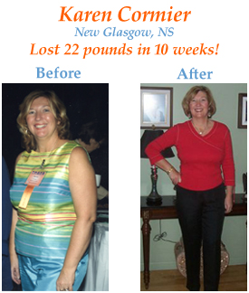
Case study 5 - Karen
Weight 76.3 kg
BMI 28.2 kg/m²
Type 2 diabetes for 6 years
Medication: Gliclazide, Metformin, Lisinopril
HbA1c 77mmol/mol (9.2%)

Slide 73
Karen – dietary intake
Breakfast | Skips breakfast – doughnut or pastry mid-morning Cooked breakfast at weekends
Mid-morning | See above
Lunch | Buffet – sandwiches, quiche, salad, deep fried samosas, cheese pastries, meringues, cake, fruit,
Mid-afternoon | Tea
Evening meal | Eats with children – pizza and salad, oven chips and Quorn sausages, cheese omelette, macaroni cheese, prepared vegetarian pies and pasties
During evening | Mixed nuts and raisins, crisps, fruit

Slide 74
Karen – what did she do?
Decided to try Slim-Fast
Substituted breakfast with a milk-shake
Substituted lunch with a soup or pasta dish
Ate a low fat vegetarian evening meal
Drank 2 glasses of dry white wine on Saturday and Sunday only

Slide 75
Karen
Weight 67kg
BMI 24.7 kg/m²
HbA1c 64mmol/mol (8.0%)
No change in medication

Slide 76
Karen – before and after

Slide 77
Diabetes competencies
Section 10. | Pre-conception, gestational diabetes and pregnancy

Slide 78
Pregnancy and diabetes
Sophie Roberts
Diabetes Specialist Dietitian
OCDEM
Churchill Hospital
Oxford OX3 7LJ
Sophie.Roberts@ouh.nhs.uk

Slide 79
Case Study – Pre-conception
Mandy is 32 years old and has had Type 1 Diabetes for 11 years. You meet her on the ward where she has been admitted after an episode of diabetic ketoacidosis. Her last A1c test result was 66.1 mmol/mol (8.2 %). She tells you that she is really frustrated that she has ended up in hospital as she is trying really hard to manage her diabetes herself, especially as her and her husband are trying for a baby. She is really keen to do things properly and has started taking pregnacare everyday.
What is it important for Mandy to think about pre-conception?

Slide 80
Diabetes in pregnancy
Risks and potential complications
Increased risk of miscarriage, congenital malformation, stillbirth and neonatal death
Neonatal hypoglycaemia
Macrosomia (risk to mother and baby)
Developing obesity or type 2 diabetes later in life

Slide 81
Diabetes in pregnancy
Blood glucose control
NICE guidelines²¹ state:
Targets should be individualised
Women should be reassured that any reduction in HbA1c level towards the target of 48 mmol/mol (6.5%) is likely to reduce the risk of congenital malformations in the baby
Women with diabetes whose HbA1c level is above 86 mmol/mol (10%) should be strongly advised not to get pregnant because of the associated risks

Slide 82

Diabetes in pregnancy
Increased folic acid requirement
Recommended from pre-conception to 12 weeks
Correct dose of great importance – 5mg/day
A typical pregnancy multi-vitamin provides 0.4mg

Slide 83
Diabetes in pregnancy – care and support
Pre-conception
Refer to regular OCDEM pre-conception group
Consider other factors
Diabetes medication review
InSight group
Referral to diabetes specialist dietitian
During pregnancy
Regular appointments at the diabetes clinic in the Silver Star Unit, JR
Support from multi-disciplinary team, including diabetes specialist dietitians

Slide 84
Diabetes in pregnancy - summary
For women with type 1 OR type 2 diabetes planning a pregnancy:
Good blood glucose control BEFORE and DURING pregnancy is vital
Correct folic acid dose
Refer on for appropriate support

Slide 85
Gestational diabetes
High risk groups
BMI >30 kg/m²
Previous macrosomic baby weighing >4.5 kg
Previous gestational diabetes
Family history of diabetes (first‑degree relative with diabetes)
Ethnic origin with a high prevalence of diabetes

Slide 86
Gestational diabetes
Supporting high risk individuals
Discuss increased risk of GDM if appropriate
Offer lifestyle advice, including weight management (or refer on)
Reassure them about support and process:
Routine testing 24–28 weeks gestation
Controlled by diet and exercise, and often also medication
Regular MDT support
Blood glucose lowering treatment is usually stopped after birth
Offered a fasting plasma glucose test 6–13 weeks
Increased risk of type 2 diabetes (70% within 10 years²²)

Slide 87
Diabetes competencies
Section 12. | Ethnic diets

Slide 88
Ethnic diets
Louise Westlake
Diabetes Specialist Dietitian
OCDEM
Churchill Hospital
Oxford OX3 7LJ
Louise.Westlake@ouh.nhs.uk

Slide 89
Ethnic groups in England and Wales 2011
86%
Prevalence (%)
7.5%
3.3%
2.2%
1.0%
White
Asian/
Asian British
Black/Black
Caribbean/
Black British
Mixed/Multiple
Ethnic Groups
Other
Source: ONS 2011²³

Slide 90
Ethnic groups in Oxford 2011
86%
77.7%
England and Wales
Oxford
Prevalence (%)
12.4%
7.5%
4.6%
3.3%
2.2%
3.9%
1.0%
1.4%
White
Asian/
Asian British
Black/Black
Caribbean/
Black British
Mixed/Multiple
Ethnic Groups
Other
Source: ONS 2011²³

Slide 91
Changes in ethnic diversity in Oxford
Ethnic diversity in Oxford is increasing²³
The proportion of the population belonging to a BME group has increased over the past decade
22% of Oxford residents now belong to a BME group, compared to 13% across the whole of England
The largest BME groups in Oxford are:
Pakistani
Indian
Black African
Other Asian
Chinese

Slide 92
BME groups and type 2 diabetes
Which BME groups have the highest prevalence of type 2 diabetes?
12
Diabetes prevalence (%)
10
8
6
4
2
0
24
Source: Health Survey for England 2004²¹
24

Slide 93
Nutrition, ethnicity and type 2 diabetes
What are the major nutritional factors to consider?
Starchy carbohydrate
Large portion sizes, multiple sources within a meal
Fat
Sources of SFA , liberal use in recipes, cooking methods
Salt
Added salt, salted snacks, premixed seasonings
Fruit and vegetables
Overcooking & reheating
Energy
Social importance of traditional energy dense foods
Sugar sweetened beverages
Inclusion of energy dense Western style foods
Increased prevalence of obesity in some groups

Slide 94
Fasting
What are the risks of fasting for people with type 2
diabetes?
During the fast period
Hypoglycaemia
Dehydration
Breaking the fast
Hyperglycaemia (especially if feasting)

Slide 95
Ramadan
Practised by followers of Islam (Muslims)
Fasting for religious reasons from dawn until sunset (no food, fluid or oral medication)
Usually involves 2 meals – at sunset (Iftar) and before dawn (Sehri)
Ramadan lasts for 29-30 consecutive days and fasts last between 10-20 hours, depending on the time of year
Over the next decade, Ramadan in the UK takes place during the summer months, increasing the risk of hypoglycaemia and dehydration

Slide 96
Risk assessment in Ramadan
Low risk | Medium risk | High risk
Diet-controlled T2DM Well-controlled T2DM taking medication without risk of hypoglycaemia | Moderately controlled T2DM with no major complications Well-controlled T2DM taking sulfonylureas | Type 2 diabetes T2DM using multiple insulin injections Poorly controlled diabetes Hypoglycaemia unawareness Cardiac, renal or hepatic problems or poor vision Acute illness e.g. foot ulcer Pregnancy

Slide 97
Diabetes and Ramadan
People with diabetes are exempt from fasting and can choose instead to make a donation to charity
Many people with diabetes will nevertheless want to participate
How can people with diabetes fast more safely?

Slide 98
Diabetes and Ramadan: MCB Guidelines
The Muslim Council of Britain and Diabetes UK publish guidelines for fasting during Ramadan²⁵ and advise:
Seek medical advice 2 months prior to Ramadan
Continue to take medications. Medication adjustment (timing and/or dosage) is usually required
Monitor blood glucose levels
Break the fast if blood glucose levels <3.3 or >16 mmol/l
Do not fast if blood glucose level is <3.9mmol/l at the start of fasting (if taking insulin or gliclazide)
Drink plenty of sugar free fluids between Iftar and Sehri
Move Sehri from midnight to just before sunrise

Slide 99
Diabetes competencies
Section 11. | Older adults

Slide 100
Older adults with diabetes
10 - 30% of older adults (>65 yrs) in Western countries have diabetes
Management should focus on individualising treatment with respect to:
Safety
Maintaining independence, functional status and quality of life
Symptom management
Reducing the impact of co-morbidities
Glycaemic targets may be relaxed in elderly people²⁶

Slide 101
Nutritional considerations
Fluid and hydration
Nutrient-dense diet:
Decreased lean body mass
Energy requirements decrease with age
Diminished appetite
Physical function may affect food choices:
Dentition
Poor eyesight
Dementia
Reluctance to cook or prepare food
Many older people live in institutions and food choices are out of their control

Slide 102
Diabetes competencies
Section 13. | Eating disorders

Slide 103
Eating disorders
Eating disorders include:
Anorexia nervosa (AN)
Bulimia nervosa (BN)
Binge eating disorder (BED)
Pica
Ruminant disorder
Avoidant/restrictive food intake disorder (ARFID)
Other specified feeding or eating disorder (OSFED)
Unspecified eating disorder (UFED)²⁷

Slide 104
Eating disorders
Eating disorder | High risk groups | Prevalence (general) | Prevalence (diabetes)
Anorexia | Adolescent girls | 0.3% among young women
Bulimia Insulin omission | Adolescent girls | 1% among young women _
Binge eating | Type 2 diabetes | Women: 1.9% Men: 0.3%
All ED |  | 1-5%
Similar
2.5 times
more common
30-40%
5-9%
30-60%
Gagnon et al, Diabetes Educator 2012²⁸

Slide 105
Risk factors for eating disorders
Adolescent female
A history of dieting or eating restraint, weight change or dissatisfaction with body weight or shape
Low self-esteem
Family dysfunction
Diabetes:
Weight loss before diagnosis may be seen as positive
Insulin initiation brings unwanted weight gain
Managing diabetes focuses on food and weight
Fear of hypoglycaemia can lead to insulin omission

Slide 106
Eating disorders
If a serious eating disorder is suspected, referral to a mental health team is recommended

Slide 107
Diabetes competencies
Section 14. | Coeliac disease

Slide 108
Coeliac disease (CD)
The prevalence of coeliac disease in the UK is approximately 10%, but only 24% of those with CD are diagnosed
People with type 1 diabetes have a 4-7% increased risk of coeliac disease
There is no increased risk with type 2 diabetes
Most cases of CD in those with type 1 diabetes are asymptomatic
Treatment is a gluten-free diet
Referral to a specialist dietitian is recommended

