Slide 1
Diabetes Competencies
Angela Hargreaves
Dietetic Team Leader – Diabetes and Behaviour Change
OCDEM
Churchill Hospital
Oxford OX3 7LJ
angela.hargreaves@ouh.nhs.uk
Pamela Dyson
Research Dietitian
University of Oxford
OCDEM
Churchill Hospital
Oxford OX3 7LJ
pamela.dyson@ocdem.ox.ac.uk

Slide 2
Diabetes Competencies: Aims
To provide training for non-diabetes specialist dietitians to ensure they meet the relevant competencies for their employment band

Slide 3

Competency Framework 2011
Written and published in 2011¹
Lists 17 separate competencies
Each competency matched to a specific NHS band
Assessment recommended²

Slide 4
List of competencies
Pathophysiology, epidemiology and clinical diabetes guidelines
Teaching and learning skills
Individualised self-management education
Psychosocial and behavioural approaches
Group-based structured education
Principles of medical nutrition therapy
Short-term complications
Specific nutrition related needs of children and adolescents
Co-morbidities
Specific nutrition related needs in gestational diabetes and pregnancy
Specific nutrition related needs of older adults
Specific nutrition related needs of people from ethnic groups
Eating disorders
Coeliac disease
Prescribable diabetes medication
Evaluation and research
Team, programme and business management

Slide 5
List of competencies – Session 2
Pathophysiology, epidemiology and clinical diabetes guidelines
Teaching and learning skills ✔
Individualised self-management education ✔
Psychosocial and behavioural approaches ✔
Group-based structured education ✔
Principles of medical nutrition therapy
Short-term complications✔
Specific nutrition related needs of children and adolescents ✗
Co-morbidities ✔
Specific nutrition related needs in gestational diabetes and pregnancy
Specific nutrition related needs of older adults
Specific nutrition related needs of people from ethnic groups
Eating disorders
Coeliac disease
Prescribable diabetes medication ✔
Evaluation and research ✗
Team, programme and business management ✗

Slide 6
Prescribable medications
Pamela Dyson
Research Dietitian
University of Oxford
OCDEM
Churchill Hospital
Oxford OX3 7LJ
pamela.dyson@ocdem.ox.ac.uk

Slide 7
Guidelines for medication
Type 1 diabetes
There are no published consensus guidelines
NICE guidance states that metformin may be added as adjunct therapy for those with BMI >25kg/m² (Asians: BMI >23kg/m²)³
Type 2 diabetes
Joint guidelines have been developed by the ADA/EASD⁴
NICE guidelines include a treatment algorithm⁵

Slide 8
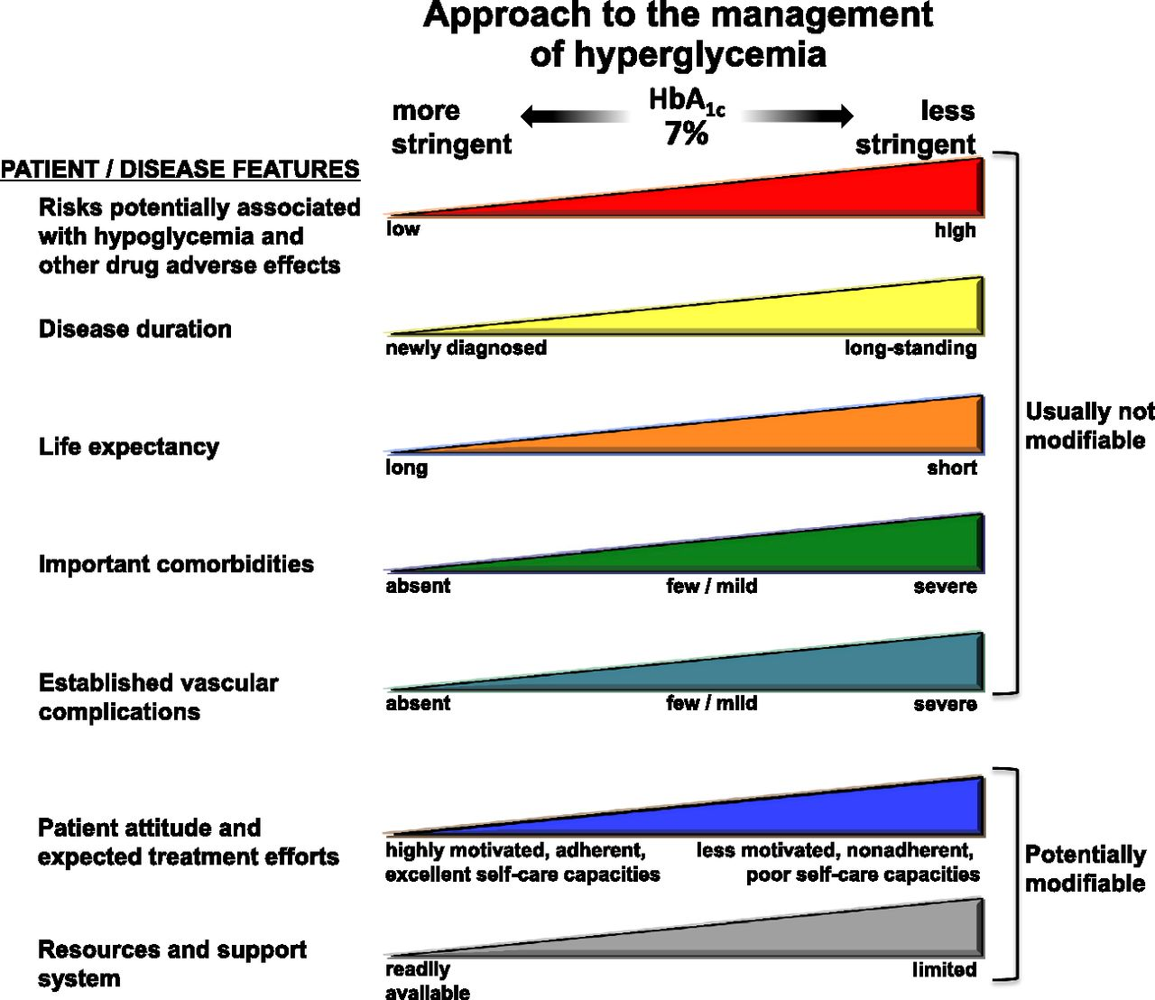
Hyperglycaemia management: Type 2
Inzucchi et al. Diabetes Care 2015⁴
Notes:
Depiction of the elements of decision-making used to determine appropriate efforts to achieve glycaemic targets. Greater concerns about a particular domain are represented by increasing height of the ramp. Thus, characteristics/predicaments towards the left justify more stringent efforts to lower HbA1c, whereas those towards the right are compatible with less stringent efforts. Where possible, such decisions should be made in conjunction with the patient, reflecting his or her preferences, needs and values. This ‘scale’ is not designed to be applied rigidly but to be used as a broad construct to help guide clinical decisions.

Slide 9
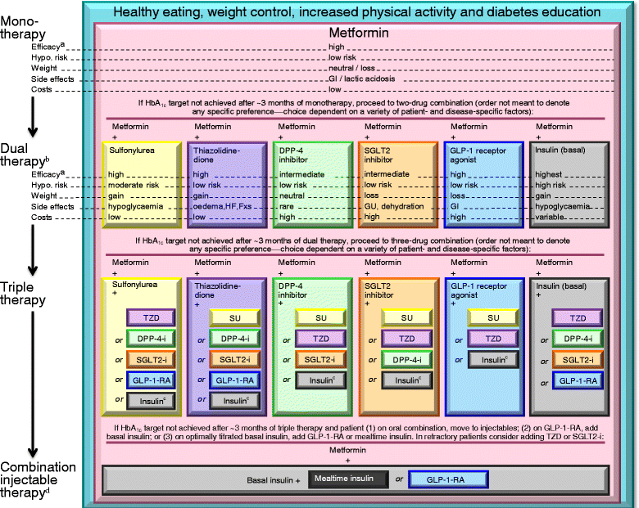
Hyperglycaemia management: Type 2⁴

Slide 10
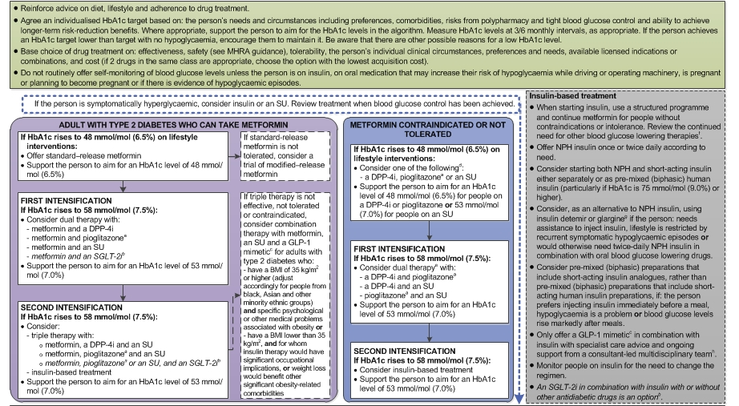
Hyperglycaemia management: NICE⁵

Slide 11
Overview of hyperglycaemia management
Monotherapy:
Metformin
Dual therapy:
Metformin
+ 2nd oral agent
Diet and
physical
activity
GLP-1 mimetics may be added
Triple therapy:
Metformin
+ 2nd oral agent
+ 3rd oral agent
Begin with single dose of long-acting insulin
Insulin

Slide 12
‘Ideal’ type 2 diabetes medication
The ideal type 2 diabetes medication should:
Increase insulin secretion
Increase insulin sensitivity
Reduce hepatic glucose production
Reduce risk of cardiovascular disease
Have no side effects, especially hypoglycaemia
Be weight/neutral or promote weight loss
Require no extra monitoring (blood tests/liver function)
Be easy to take
Fit in with life/maintain quality of life

Slide 13
Action of diabetes medication
Increases insulin secretion
Sulfonylureas
GLP-1 mimetics
DPP-4 inhibitors
Increases insulin sensitivity
Metformin
Glitazones
Reduces hepatic glucose
Metformin
GLP-1 mimetics
DPP-4 inhibitors
Reduces appetite
GLP-1 mimetics
Metformin?
Inhibits renal glucose reabsorption
SGLT-2
Insulin replacement
Insulin

Slide 14
Biguanide (Metformin)
Recommended as first line therapy: reduces HbA1c by 13 mmol/mol (1.1%)
Dosing: tablets taken with or after food
Most common side effects: mainly GI
Monitor: renal/liver function
Caution: eGFR < 50ml/min
Stop: eGFR < 30ml/min
Usual maximum dose: 2g/day
Additional:
Associated with B12 deficiency
Safe in pregnancy
Available as slow release formulation
Increases insulin secretion | ✗
Increases insulin sensitivity | ✓
Reduces liver glucose output | ✓
Weight neutral | ✓
Does not cause hypos | ✓
Cardioprotective | ✓

Slide 15

Biguanide (Metformin)
LACTIC ACIDOSIS
Very rare complication associated
with metformin use
Arises when lactic acid builds up in the
bloodstream faster than it can be removed
Risk is increased with
  kidney, respiratory and heart failure
  dehydration

Slide 16
Sulfonylureas: regular
The ‘….ides’ e.g. gliclazide. Reduce HbA1c by 17 mmol/mol (1.5%)
Dosing: tablets taken before food
Most common side effects: GI (mild), hypoglycaemia, weight gain (mean 3kg)
Monitor: renal/liver function
Caution: in elderly (increased risk of hypoglycaemia)
Usual maximum dose: 160mg bd
Additional: Modified release version available, but not normally recommended
Increases insulin secretion | ✓
Increases insulin sensitivity | ✗
Reduces hepatic glucose output | ✗
Weight loss/neutral | ✗
Does not cause hypos | ✗
Cardioprotective | ✗

Slide 17
Sulfonylureas: prandial glucose regulators
The ‘glinides’ e.g. rapaglinide. Reduce HbA1c by 6-15 mmol/mol (0.5-1.3%)
Dosing: tablets taken before main meals
Most common side effects: GI (mild), hypoglycaemia
Monitor: renal/liver function
Caution: in elderly over 75 years
Usual maximum dose: 16mg daily in
4mg doses
Additional: only licensed for monotherapy or with Metformin
Increases insulin secretion | ✓
Increases insulin sensitivity | ✗
Reduces hepatic glucose output | ✗
Weight loss/neutral | ✓
Does not cause hypos | ✗
Cardioprotective | ✗

Slide 18
Sulphonylureas
HYPOGLYCAEMIA
Annual prevalence of severe
hypoglycaemia associated with
sulphonylurea therapy is 7%⁶
Use of sulphonylureas increases the risk of hypoglycaemia by 3.73⁷
Risk factors include:
  Length of treatment
  Age over 60 years
  Strict glycaemic control
  Renal impairment

Slide 19
Thiazolidinediones: TZDs
The ‘glitazone’s e.g. pioglitazone. Reduce HbA1c by 11mmol/mol (1%)
Dosing: tablets taken once daily with or without food
Most common side effects: GI, fluid retention, weight gain (~3kg)
Monitor: liver function
Usual maximum dose: 45mg daily
Additional:
Slow onset (up to 6 months)
Reduces liver fat
Can be used with insulin
Increases insulin secretion | ✗
Increases insulin sensitivity | ✓
Reduces liver glucose output | ✓
Weight loss/neutral | ✗
Does not cause hypos | ✓
Cardioprotective | ✗

Slide 20
Thiazolidinediones: TZDs (Pioglitazone)
Should be used with caution in
those with heart failure
Increased risk of long bone fracture
in postmenopausal women
Small increased risk of bladder cancer⁸

Slide 21
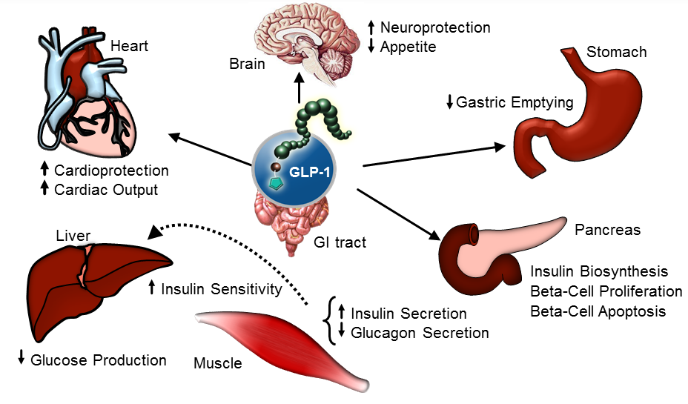
Incretin-based therapies (GI hormones)

Slide 22
GLP-1 mimetics
Lixisenatide*, Exenatide*, Liraglutide. *First line treatments locally
Reduce HbA1c by 11 mol/mol (1.0%)
Increases insulin secretion | ✓
Increases insulin sensitivity | ✓
Reduces liver glucose output | ✓
Weight loss | ✓
Does not cause hypos | ✓
Cardioprotective⁹ | ?
Dosing: injectable therapies with options including once or twice daily and once weekly
Most common side effects: GI, nausea, vomiting
Monitor: renal/liver function
Additional: offers realistic chance of weight loss

Slide 23
GLP-1 mimetics
Daily formulations:
Exenatide* (Byetta): taken twice daily within 1 hour of eating
Lixisenatide* (Lyxumia): taken once daily within I hour of eating
Liraglutide (Victoza): taken once daily
Weekly formulations:
Bydureon: once weekly form of Byetta
Dulaglutide (Trulicity): consultant approval only

Slide 24
GLP-1 mimetics
NICE guidance⁵
If triple therapy with metformin and 2 other oral drugs (sulfonlyurea, pioglitazone and DPP-4 inhibitor) is not effective, then consider GLP-1 in those with:
  BMI >35kg/m² (adapted for BME groups) and specific psychological or medical problems
  BMI <35kg/m² and:
    for whom insulin therapy would have significant occupational implications or
    weight loss would improve obesity-related co-morbidities
Only continue GLP-1 mimetic therapy if there is a reduction of 11 mmol/mol (1.0%) in Hb1c and weight loss of at least 3% over 6 months

Slide 25
DPP-4 inhibitors (Gliptins)
Alogliptin*, Linagliptin*, Saxagliptin, Sitagliptin. *1st line treatments locally
Reduce HbA1c by 8 mmol/mol (0.75%)
Increases insulin production | ✓
Increases insulin sensitivity | ✗
Reduces liver glucose output | ✓
Weight neutral | ✓
Does not cause hypos | ✓
Cardioprotective | ✗
Dosing: tablets taken with or after food
Most common side effects: GI, URTI, oedema
Monitor: renal/liver function
Additional:
Linagliptin can be used in end stage renal failure without reducing dose
Full effect seen between 3-6 months

Slide 26
GLP-1 mimetics and DPP-4 inhibitors
Monitor renal function
Avoid in severe liver impairment
Contraindicated in previous DKA
Stop treatment if any symptoms of acute pancreatitis (patients should be made aware of symptoms)

Slide 27
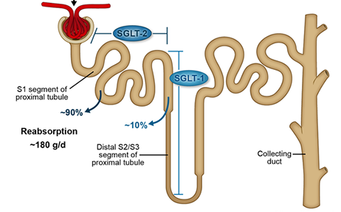
SGLT-2 inhibitors
~200g glucose filtered per day
SGLT-2 inhibition prevents reabsorption
of 30-50% of glucose in the proximal tubule
✗
Proximal tubule
SI sProximal
Glucose excreted
in urine
~90%
~10%
✗
Reabsorption
~200g per day
No glucose
excreted in
urine
Collecting
duct
Distal segment

Slide 28
SGLT-2 inhibitors
Dapagliflozin (Forxiga), Empaglifloxin (Jardiance), Canagliflozin (Invokana)
Reduce HbA1c by 5-11 mmol/mol (0.5-1.0%)
Increases insulin secretion | ✗
Increases insulin sensitivity | ✗
Reduces liver glucose output | ✗
Weight loss | ✓
Does not cause hypos | ✓
Cardioprotective¹⁰ | ?
Dosing: once daily
Most common side effects: UTI
Monitor: liver function
Additional:
Realistic chance of weight loss
Not recommended by current NICE guidance but ‘may be appropriate for some people’

Slide 29
SGLT-2 inhibitors
Monitor renal function: efficacy decreases with lower eGFR
Very rarely may precipitate DKA (mechanism unknown) in 0.1 – 0.01%
Some recent suggestion that Canagliflozin is associated with increased risk of lower limb amputation

Slide 30
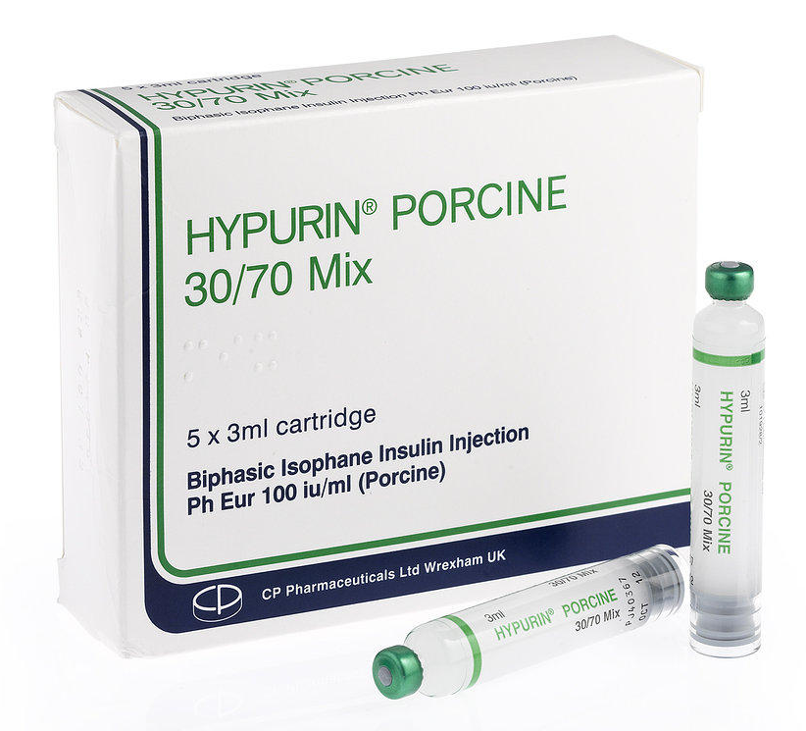

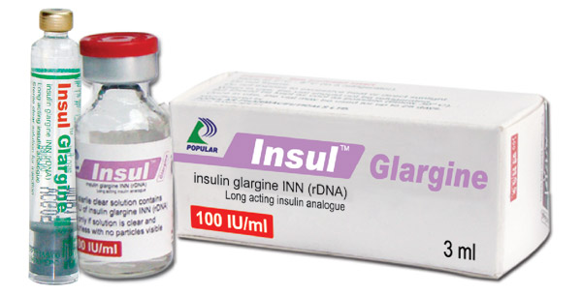
Insulin
Insulin is derived from three sources:
Animal insulin (porcine and bovine)
Human insulin (produced by recombinant DNA technology)
Analogue insulin (produced by modifying end chain amino acids of human insulin molecules)

Slide 31
Human insulin
Prandial/Bolus (short-acting) | Absorbed quickly and designed to cover postprandial glucose excursions e.g. Actrapid®, Humulin S®
Basal/Background (longer-acting) | Absorbed more slowly and designed to provided background insulin over 24 hours e.g. Insulatard®, Humulin I®, Insuman Basal (Human isophane (NPH) insulins)
Pre-mixed | A mixture of prandial and basal insulin Humulin M3®, Insuman Comb 15/25/50 (Biphasic human insulin)

Slide 32
Analogue insulin
Prandial/Bolus (short-acting) | Absorbed very rapidly and designed to cover postprandial glucose excursions e.g. NovoRapid® (insulin aspart), Humalog® (insulin lispro), Apidra® (insulin glulisine)
Basal/Background (longer-acting) | Longer acting and designed to provide stable levels of background insulin over 24 hours e.g. Levemir® (insulin detemir), Lantus® and Abasaglar (insulin glargine), Degludec (insulin tresiba)
Pre-mixed | A mixture of rapid and intermediate acting insulin e.g. NovoMix® 30, Humalog® Mix 25 and Humalog® Mix 50

Slide 33


Prandial/Bolus (short-acting) insulin
Human insulin
Actrapid®, Humulin S®
Analogue insulin
NovoRapid® (Aspart), Humalog®
(Lispro), Apidra® (Glulisine)
Action
Action
Time (hours)
Time (hours)
Onset: 30 minutes
Peak: 1 - 3 hours
Duration: 6 - 8 hours
Onset: 5 minutes
Peak: 1 - 1½ hours
Duration: 3 - 5 hours

Slide 34
Prandial/Bolus (short-acting) insulin
Human insulin
Actrapid®, Humulin S®
Taken with meals (3 times daily)
Should be given 30 minutes before eating
Long duration of activity
Risk of late post-prandial hypoglycaemia
Analogue insulin
NovoRapid® (Aspart), Humalog® (Lispro), Apidra® (Glulisine)
Rapid onset of action
Should be injected with food
Less risk of post-prandial hypoglycaemia
Improves flexibility and promotes ease of carbohydrate counting

Slide 35
Basal/Backgound (longer-acting) insulin
background human insulin
background analogue insulin
Insulin action
Time
Analogue insulin
Levemir® (Detemir), Lantus®
(Glargine)
Onset:
Peak:
Duration: 18 - 24 hours
Human insulin
Insulatard®, Humulin I®,
Insuman Basal (NPH)
Onset: 1½ - 2 hours
Peak: 5 - 8 hours
Duration: 12 - 24 hours
‘Flat insulin’

Slide 36
Basal/Backgound (longer-acting) insulin
Human insulin
Insulatard®, Humulin I®,
Insuman Basal
Taken once or twice daily
Often used alone for type 2 diabetes
Length of action variable
May cause hypoglycaemia at peak action
Often requires bedtime snack
Analogue insulin
Levemir® (Detemir), Lantus®
(Glargine)
Taken once or twice daily
Usually used for type 1 diabetes
No peak
Reduced risk of hypoglycaemia
No bedtime snack required

Slide 37
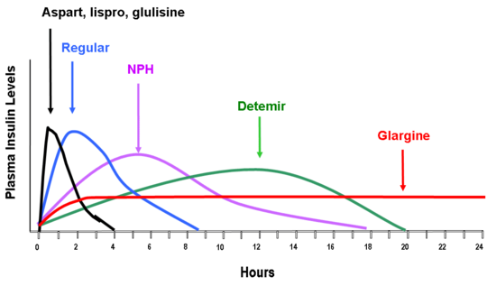
Comparison of insulin action
Prandial analogue insulin (Aspart, Lispro, Glulisine)
Prandial human insulin (Actrapid, Humalin S)
Plasma insulin levels
Basal human insulin (NPH)
Basal analogue (Detemir)
Basal analogue (Glargine)
Hours

Slide 38
Pre-mixed insulin
Premixed human
insulin
Premixed analogue
insulin
Insulin action
Breakfast
Lunch
Dinner
Human insulin
Humulin M3®, Insuman Comb 15/25/50
Onset: 30 minutes
Peak: 2 – 8 hours
Duration: 12 – 24 hours
Analogue insulin
NovoMix® 30, Humalog® Mix 25/50
Onset: 12 - 20 minutes
Peak: 1 - 4 hours
Duration: 18 - 20 hours

Slide 39
Pre-mixed insulin
Usually taken twice daily (before breakfast and evening meal)
Different combinations available enabling tailoring to the individual
Analogue pre-mixed insulin reduces:
  Risk of hypoglycaemia
  Need to snack

Slide 40
What’s new?
Very long acting insulin (up to 42 hours) e.g. Degludec (Tresiba©)
New strength insulins e.g. Toujeo (300 unit/ml Lantus) Humalog U-200 KwikPen (200 unit/ml Lispro)
Biosimilar insulins e.g. Abasaglar (contains Glargine, but manufactured by Lilly rather than Sanofi)
Combinations of long acting insulin and GLP-1 mimetics e.g. Xultophy: Degludec and Liraglutide
New once weekly GLP-1 mimetic (Trulicity)
New insulin pens (Novopen 5)

Slide 41
Diabetes competencies
Section 7. | Short-term complications

Slide 42
Short-term complications
Hypoglycaemia
Diabetic ketoacidosis (DKA)

Slide 43
Hypoglycaemia
What is the normal blood glucose range for someone without diabetes?
  3.5 - 7.8mmol/l
What is hypoglycaemia?
  Medical term for low blood glucose levels
  Blood glucose levels < 4mmol/l (4 is the floor!)
Do people without diabetes have hypos?
  Rarely, and usually associated with bariatric surgery, insulinoma and idiopathic postprandial hypoglycaemia

Slide 44
Main causes of hypoglycaemia
Excess insulin
Inadequate carbohydrate intake
Increased physical activity
Missed or delayed meal
Alcohol

Slide 45
Symptoms of hypoglcaemia
Early symptoms:
Feeling hungry
Sweating
Dizziness
Tiredness or fatigue
Blurred vision
Trembling or shakiness
Palpitations
All associated with the counter-regulatory hormone response

Slide 46
Symptoms of hypoglycaemia
More advanced symptoms:
Irritability
Difficulty concentrating
Confusion
Disorderly or irrational behaviour
Associated with lack of glucose in the brain
May lead to coma and (rarely) death

Slide 47
Prevalence of severe hypoglycaemia
Type of diabetes | Prevalence (%)
Type 1: Duration <5 years Duration >15 years | 22 46
Type 2: Oral medication Insulin <2 years Insulin > 5 years | 7 7 25
Source: UK Hypoglycaemia Study Group, Diabetologia 2007¹¹

Slide 48
Prevalence of hypoglycaemia in type 2 diabetes
Medication | Prevalence (%) Mild/mod Severe |  | Incidence (per person/year) Mild/mod Severe
Insulin | 50 | 21 | 23 | 1
Oral meds | 30 | 50 | 2 | 0.01
All meds | 45 | 6 | 19 | 0.08
Source: Edridge et al, PLoS One 2015¹²

Slide 49
Treatment of mild hypoglycaemia
The 15 rule:
15 – 20g fast acting glucose
Re-test blood glucose levels after 15 minutes to check that they are rising
If glucose levels not rising, repeat treatment
An extra 15-20g carbohydrate from any source may be necessary if meal not due
May need to decrease insulin at next meal

Slide 50








Sources of 15g fast acting glucose
5 small or 4 large glucose tablets
5 jelly babies, fruit pastilles
or wine gums
10 jelly beans
80 ml Lucozade
150 ml Coke

Slide 51
Diabetic ketoacidosis (DKA)
Who is most at risk of DKA?
  People with undiagnosed type 1 diabetes
  People with type 1 diabetes who develop intercurrent ilnesses
  Adolescent females with type 1 diabetes who omit insulin

Slide 52
Symptoms of DKA
Increased urination
Thirst
Nausea and vomiting
Tiredness and fatigue
Abdominal pain
Shortness of breath or panting
Smell of ketones on the breath
Confusion
Drowsiness or loss of consciousness

Slide 53
Treatment of DKA
Fluids
Insulin
People with type 1 diabetes and an intercurrent illness are advised to:
  Test blood glucose levels regularly
  Test ketone levels
  Continue to take insulin, even if they are not eating

Slide 54
Diabetes competencies
Section 9. | Co-morbidities

Slide 55
Microvascular co-morbidities
Retinopathy
Nephropathy
Neuropathy

Slide 56
Retinopathy
What are the risk factors for diabetic retinopathy?
  Duration of diabetes
  Poor glycaemic control
  Hypertension
  Hypercholestraemia
  Pregnancy
Which nutritional factors can reduce risk?
  Improvements in glycaemic control, blood pressure and lipid levels

Slide 57
Nephropathy
What are the risk factors for nephropathy?
  Genetic susceptibility
  Ethnic background
  Duration of diabetes
  Poor glycaemic control
  Hypertension
  Obesity
Which nutritional factors can reduce risk?
  Improvements in glycaemic control and blood pressure and weight loss

Slide 58
Neuropathy
What are the risk factors for neuropathy?
  Duration of diabetes
  Poor glycaemic control
  Obesity
  Smoking
  Renal disease
Which nutritional factors can reduce risk?
  Improving glycaemic control and weight loss
  Reducing or avoiding alcohol

Slide 59
Macrovascular co-morbidities
Alison Ions
Diabetes Specialist Dietitian
OCDEM
Churchill Hospital
Oxford OX3 7LJ
@ouh.nhs.uk

Slide 60
Macrovascular Disease
Increased risk in people with diabetes
‘People with diabetes have the equivalent cardiovascular disease (CVD) risk as people with
pre-existing CVD’¹³
Notes:
Ask why important to consider CVD with patients with diabetes.
are 2-3 times more likely to suffer a stroke that the non-diabetic population and up to five times more likely to die from cardiovascular disease (CVD)
Equivalent CVD risk as people with pre-existing CVD and no diabetes
OR Type 2 2-3 times more likely to CVD
Associated with hyperglycaemia but, in contrast to microvascular not so much due to elevated blood glucose per se but to disturbances in other metabolic parameters such as blood lipids, which occur in the presence of poor glycaemic control. Hypertension, obesity, smoking, inactivity. If dietary advice imp for glycaemic control then good practice to offer to those with complications
The high blood glucose (sugar) levels associated with diabetes can damage the artery walls, making them more likely to develop fatty deposits (atheroma).
A Diabetes UK report from 2007 estimates that the risk of cardiovascular disease in people with diabetes is: ^{[1]}
5 times higher in middle aged men
8 times higher in women with diabetes.

Slide 61
Macrovascular disease
What is cardiovascular disease?
Coronary artery disease
Peripheral artery disease
Stroke
Notes:
Coronary heart disease is the term that describes what happens when your heart's blood supply is blocked or interrupted by a build-up of fatty substances in the coronary arteries.
Over time, the walls of your arteries can become furred up with fatty deposits. This process is known as atherosclerosis and the fatty deposits are called atheroma.
As well as angina (chest pain), the main symptoms of CHD are heart attacks and heart failure
Peripheral arterial disease (PAD) is a common condition, in which a build-up of fatty deposits in the arteries restricts blood supply to leg muscles. It is also known as peripheral vascular disease (PVD).
Many people with PAD have no symptoms. However, some develop a painful ache in their legs when they walk, which usually disappears after a few minutes' rest. The medical term for this is "intermittent claudication".
PAD is a form of cardiovascular disease (CVD), meaning it affects the blood vessels.
It is usually caused by a build-up of fatty deposits in the walls of the leg arteries. The fatty deposits, called atheroma, are made up of cholesterol and other waste substances.
The build-up of atheroma on the walls of the arteries makes the arteries narrower and restricts blood flow to the legs. This process is called atherosclerosis.

Slide 62
Case Study - Adam
Type 2 diabetes for 5 years
Weight 116.4kg
BMI 36.7kg/m²
Total cholesterol 6.3 mmol/l
LDL cholesterol 4.3 mmol/l
HDL Cholesterol 1.3 mmol/l
HbA1c 60 mmol/mol
Blood pressure 145/80
Diabetes medications: Metformin

Slide 63
Adam – dietary intake
Breakfast: Half a pint of peach yoghurt and a pain au chocolat OR sausage, hash brown and poached egg sandwich on white bread with butter
Lunch: Banana and a packet of chicken crisps
Evening meal: Pizza or takeaway OR eats at work (restaurant food) e.g. venison with potatoes and 2 vegetables or salmon with potatoes and 2 vegetables
Twice per week has home cooked meal e.g. shepherds pie, pasta with chicken and vegetables
Drinks: 5 coffee with 4 sugars each, 1 pint of coke (non-diet) and 2 beers
Snacks: Chocolate raisins, marshmallows, jelly babies, cheese and biscuits. Snacks in the evening most days

Slide 64
Case study - Adam
What other information might you want to find out from Adam?
Would you measure Adam’s waist circumference?
What recommendations would you make?

Slide 65
Lipid Targets
Diabetes UK¹⁴ recommend the following:
Total cholesterol - below 4.0 mmol/l
LDL cholesterol - less than 2.0 mmol/l
HDL cholesterol - 1.0 mmol/l or above in men and 1.2 mmol/l or above in women
Triglycerides - 1.7 mmol/l or less
Notes:
Targets:
PAL/lifestyle (smoking etc)
Central obesity = increased risk but BMI >35kg/m therefore would not measure waist circumference as little added predictive power of CVD risk and difficult to do (WHO)

Slide 66
NICE – Lipid Modification
NICE¹⁵ recommends a cardioprotective diet for people at high risk of or with CVD in which:
Total fat intake is 30% or less of total energy intake
Saturated fats are 7% or less of total energy intake
Intake of dietary cholesterol is less than 300 mg/day
Where possible saturated fats are replaced by mono‑unsaturated and polyunsaturated fats.

Slide 67
NICE – Lipid Modification
Cholesterol lowering spreads and functional foods
Stanols or sterols for the prevention of CVD are no longer recommended for people with diabetes
Omega 3
There is no evidence that omega‑3 fatty acid compounds help to prevent CVD
Omega‑3 fatty acid compounds for the prevention of CVD are no longer recommended for people with diabetes
Notes:
Vegetarian and non vegetarian omega 3…..

Slide 68
DUK and BDA: Policy statement
A number of health professionals are actively promoting low carbohydrate, high fat diets for people with type 2 diabetes
Diabetes UK and the BDA Diabetes Specialist Group performed a critical review of the recent evidence (2000-2015) relating to dietary fat, obesity, glycaemic control, CVD risks and type 2 diabetes
A policy statement was issued in December 2015¹⁶

Slide 69
DUK and BDA Recommendations: Total Fat
There is no convincing evidence for a link between total fat intake (as % total energy) and weight gain or CVD risk in people with type 2 diabetes
Lowering total fat intake does not consistently improve glycaemic control, weight loss or CVD risk
The majority of studies investigate intakes of 20-40% energy from fat, there is little evidence for high fat diets (50-60% energy derived from fat)
In the absence of evidence, high fat diets should not be recommended for people with type 2 diabetes

Slide 70
DUK and BDA Recommendations: SFA
On balance, evidence suggests that replacing saturated fat with unsaturated fat (PUFA and MUFA) reduced the risk of CVD in in high risk populations, including people with type 2 diabetes.
Evidence suggests that Mediterranean-type diets (MUFA rich) are effective for improving glycaemic control and reducing CVD risk in people with type 2 diabetes
Replacement of saturated fat with unsaturated fat is recommended

Slide 71
DUK and BDA Recommendations: Carbohydrate
Replacement of saturated fat is by wholegrain or unrefined carbohydrate there is evidence for cardiovascular benefit
Substitution with refined carbohydrates appears to increase CVD risk
If saturated fat is replaced by carbohydrate it should be derived from unrefined sources

Slide 72
NICE and DUK/BDA recommendations
Nutrient | NICE¹⁵ | DUK/BDA¹⁶
Total fat | <30% | No specific recommendation
Saturated fat | <7% | Replace SFA with unsaturated fat
Dietary cholesterol | <300mg/day | No restriction
General | Replace SFA with unsaturated fat | Individualised advice

Slide 73
Diabetes Competencies
Section 3. Section 5. | Self-management education Group-based structured education

Slide 74
Self-management
Dietary interventions (Session 1)
Physical activity
Self-monitoring
Taking medication
Reducing risk

Slide 75
Physical activity - benefits
Type 2 diabetes
Improved glycaemic control^{17,18}
Improved quality of life^{18,19}
Reductions in cardiovascular risk¹⁷⁻¹⁹
Benefits in weight maintenance, although not effective for weight loss in isolation²⁰
Type 1 diabetes 9²¹
Reductions in cardiovascular risk
Contradictory evidence for glycaemic control
Is associated with negative effects in terms of hypo and hyperglycaemia

Slide 76
Recommendations for physical activity²²
General recommendations for diabetes: 30 minutes of moderate physical activity on most (at least 5) days of the week progressing to an additional 20 minutes of continuous, moderate to vigorous exercise on 3 days per week
Type 2 diabetes: 90-150 minutes moderately intense aerobic exercise plus resistance or weight training on 3 occasions weekly

Slide 77
Self-monitoring
Type 1³
  Test blood glucose at least 4 times a day
  And up to 10 times if control is sub-optimal, before driving, during illness, sport and pregnancy
Type 2⁵
  Self-monitoring should not be routinely offered to those managed by lifestyle and oral medicatons
  Self-monitoring should be offered to those on insulin, with evidence of hypoglycaemic episodes, those taking insulin sectretagogues and driving or operating machinery and women who are planning pregnancy or who are pregnant

Slide 78
Taking medication
Adherence to medication ranges from ~30-90%²³
Factors associated with poor adherence include:
  age, race and health beliefs and health literacy
  poor tolerance of side-effects
  medications taken more than once daily
  depression
  scepticism about importance of medication
Higher adherence is associated with improved glycaemic control, decreased hospitalisation and lower medical costs

Slide 79
Reducing risk
Reducing risk of co-morbidities by maintaining:
  Blood glucose levels as near to the normal range as possible
  Body weight within/as near to normal range as possible
  Blood pressure as near to the normal range as possible
  Physical activity levels
  And avoiding smoking and excess alcohol use

Slide 80
Group-based structured education
Diabetes team provide education groups for:
  Newly diagnosed type 2 diabetes
  On-going management of type 2 diabetes
  Carbohydrate counting and insulin adjustment
  Advanced carbohydrate counting and insulin adjustment
  Management of type 1 diabetes, including carbohydrate counting and insulin adjustment
  Weight management
  Pre-conception

Slide 81
Local, national and international support
Diabetes UK local group:
http://oxfordshire.diabetesukgroup.org/contact/
Diabetes UK : https://www.diabetes.org.uk/
European Association for the Study of Diabetes: http://www.easd.org/
American Diabetes Association:
http://www.diabetes.org/
International Diabetes Federation:
http://www.idf.org/

Slide 82
Diabetes Competencies
Section 2. | Teaching and learning skills

Slide 83
Theories of adult learning
Transtheoretical model of behaviour change²⁴
Social cognitive theory and self-efficacy²⁵
Kolb-Lewin’s cycle for adult learning²⁶
Adult learning styles²⁷
Theory of planned behaviour/reasoned action²⁸
Compassionate mind theory²⁹
Empowerment³⁰

Slide 84
Diabetes Competencies
Section 4. | Psychosocial and behavioural approaches

Slide 85
Psychosocial and behavioural approaches
Living with diabetes often requires changes to lifestyle that are challenging to achieve and sustain
Diabetes-related stress is common, particularly fear of hypoglycaemia and long-term complications
Clinical depression is more common in people with diabetes
Educational interventions that use behavioural and affective elements are more effective than didactic styles of teaching³¹

Slide 86
Case study
Mrs Brown
61 years old
78.2kg, BMI=31.3kg/m²
HbA1c 65mmol/mol (8.1%)
Lipid levels and blood pressure at target levels with medication
Metformin, gliclazide, atorvastatin, ramipril

Slide 87
Setting the agenda
There are a number of useful phrases that allow the patient to set the agenda:
  What brings you here today?
  What would you like to talk about today?
  We could talk about your diet, weight loss or physical activity. What do you think?
  Are you interested in talking about weight loss, or do you have more important concerns today?

Slide 88
Outcomes of setting the agenda
The patient is:
  Not interested in pursuing the discussion, so the consultation can end here (this almost never happens – the patient has kept the appointment for a good reason)
  Ambivalent about change
  Engaged with talking about changing a specific behaviour

Slide 89
What does a diet history tell us?
24 hour recalls show low correlation with true intake due to day-to-day variation in food intake³²
Both over and under-reporting are common³³
There is a strong inverse relationship between BMI and reported intake³⁴
Snacks and foods perceived as unhealthy are more likely to be under-reported³⁵

Slide 90
Creating resistance
Resistance arises from:
  The patient bringing it into the consulting room
  The health professional eliciting it
  A combination of the two
And often takes the form of:
  Arguing (challenging, discounting, hostility)
  Denying (blaming, disagreeing, excusing, pessimism, reluctance)
  Interrupting
  Ignoring (inattention, failing to answer, side-tracking)

Slide 91
Dealing with resistance
Emphasise personal choice and control
Assess readiness, importance or confidence
Realign with the patient by reflective listening
Paraphrase and exaggerate the claim made by the patient

Slide 92
Dealing with resistance
Emphasise personal choice and control
Assess readiness, importance or confidence
Realign with the patient by reflective listening
Paraphrase and exaggerate the claim made by the patient

Slide 93
Dealing with resistance
Emphasise personal choice and control
Assess readiness, importance or confidence
Realign with the patient by reflective listening
Paraphrase and exaggerate the claim made by the patient

Slide 94
Dealing with resistance
Emphasise personal choice and control
Assess readiness, importance or confidence
Realign with the patient by reflective listening
Paraphrase and exaggerate the claim made by the patient

Slide 95
Dealing with resistance
Emphasise personal choice and control
Assess readiness, importance or confidence
Realign with the patient by reflective listening
Paraphrase and exaggerate the claim made by the patient

Slide 96
Exploring ambivalence
Use balance sheets to explore ambivalence
List negative and positive aspects of behaviour change, both short and long-term
Weigh up positive and negative aspects and decide upon action

Slide 97
Balance sheets
The change I am thinking of making is:
 | Continue as before (no change) | Change behaviour
Pros – good things about doing this
Cons – bad things about doing this

Slide 98
Committing to change
Support commitment to change by:
Using POST
Avoiding advice giving, unless actively sought by the patient
Using passive or reflective listening
Trying to side with your patient
Encouraging them to develop their own solutions

Slide 99
POST
Problem | Define the problem
Options | List all options/solutions
Select | Analyse which could work and discard any that would not work, then select suitable option
Try | Try it out

Slide 100
Relapse prevention
Relapses are part of the cycle of change
Usual causes are unanticipated problems and boredom
It is useful to identify high-risk situations
Encourage active problem-solving using POST

